Slide 1
SHREC’13 Track: Large Scale Sketch-Based 3D Shape Retrieval
Bo Li, Yijuan Lu, Afzal Godil, Tobias Schreck
Masaki Aono, Henry Johan, Jose M. Saavedra, Shoki Tashiro
Notes:
Good afternoon, everyone. I will present our organized SHREC track whose name is Large Scale Sketch-Based 3D Shape Retrieval.
It is a joint work of the following authors and institutes.

Slide 2
Outline
Contributors
Introduction
Benchmark
Methods
Evaluation
Results
Conclusions and Future Work

Slide 3
Contributors
Organizers:
Bo Li, Yijuan Lu
Texas State University, USA
Afzal Godil
National Institute of Standards and Technology, USA
Tobias Schreck
University of Konstanz, Germany
Participants:
Masaki Aono and Shoki Tashiro
Toyohashi University of Technology, Japan
Bo Li, Yijuan Lu
Texas State University, USA
Henry Johan
Fraunhofer IDM@NTU, Singapore
Jose M. Saavedra
University of Chile, Chile
ORAND S.A., Santiago, Chile
①
②
③
Notes:
In details, the organizers are Bo Li, Yijuan Lu from Texas State University, USA;
Afzal Godil from National Institute of Standards and Technology, USA; and
Tobias Schreck from University of Konstanz, Germany.
Three groups participated in the SHREC track.
The first group is Masaki Aono and Shoki Tashiro from Toyohashi University of Technology, Japan;
The second group is Bo Li, Yijuan Lu from Texas State University, USA; and Henry Johan from Fraunhofer IDM@NTU, Singapore
The third group is Jose M. Saavedra from University of Chile, Chile and ORAND S.A., Santiago, Chile

Slide 4
Outline
Contributors
Introduction
Benchmark
Methods
Evaluation
Results
Conclusions and Future Work

Slide 5
Introduction
Sketch-based 3D model retrieval is focusing on retrieving relevant 3D models using sketch(es) as input.
Characteristics of the scheme:
Intuitive and convenient, easy for users to learn.
Popular and important for related applications, such as:
Sketch-based modeling and recognition.
3D animation production via 3D reconstruction of a 2D scene sketch.
Previous work on sketch-based 3D object retrieval has evaluated sketch-based retrieval on rather small benchmarks.
We organized this track to further foster this challenging research area by building a large scale benchmark.
Notes:
Sketch-based 3D model retrieval is focusing on retrieving relevant 3D models using sketch(es) as input.
Characteristics of the scheme:
Intuitive and convenient, easy for users to learn.
Popular and important for related applications, such as:
Sketch-based modeling and recognition.
3D animation production via 3D reconstruction of a scene of 2D storyboard.
Previous work on sketch-based 3D object retrieval has evaluated sketch-based retrieval on rather small benchmarks and compared against a limited number of methods.
We organized this track to further foster this challenging research area by building a large scale benchmark and soliciting retrieval results from current state-of-the-art retrieval methods for comparison.

Slide 6
Outline
Contributors
Introduction
Benchmark
Methods
Evaluation
Results
Conclusions and Future Work

Slide 7
Benchmark (1/5)
Motivated by the large sketch dataset built by Eitz et al. [EHA12]:
Content: 20,000 human-drawn sketches, categorized into 250 classes, each with 80 sketches.
Topics: how humans draw sketches and human sketch recognition.
Characteristics:
Exhaustive in terms of the number of object categories. (250)
Sufficiently large number of query objects per class. (80)
Equal models per class, thus avoiding query class bias. (80 each)
Sketch variation within each class is high.
A new sketch-based 3D model retrieval benchmark built on [EHA12] and PSB to foster the research of sketch-based 3D object retrieval.
A natural extension of the benchmark in [ERB*12] for very large scale 3D sketch-based retrieval.
[EHA12] EITZ M., HAYS J., ALEXA M.: How do humans sketch objects? ACM Trans. Graph. 31, 4 (2012), 44:1–44:10.
[ERB∗12] EITZ M., RICHTER R., BOUBEKEUR T., HILDEBRAND K., ALEXA M.: Sketch-based shape retrieval. ACM Trans. Graph. 31, 4 (2012), 31:1–31:10.
Notes:
Motivated by the latest large human sketches collection of built by Eitz et al. [EHA12]:
Content: 20,000 human-drawn sketches, categorized into 250 classes, each with 80 sketches.
Target: how humans draw sketches and human sketch recognition.
Characteristics:
Exhaustive in terms of the number of object categories. (250)
Sufficiently large number of query objects per class. (80)
Equal models per class, thus avoiding query class bias. (80 each)
Sketch variation within each class is high.
A new sketch-based 3D model retrieval benchmark built on [EHA12] and the PSB will foster the research of sketch-based 3D object retrieval.
A natural extension of the benchmark proposed in [ERB12] for very large scale 3D sketch-based retrieval.

Slide 8
Benchmark (2/5)
PSB [SMKF04]:
Two datasets: “test” and “train”, each has 907 models, categorized into 97 and 90 distinct classes, respectively.
Target class bias: quite different numbers of models for different classes.
[ERB*12]: creates one sketch for each model in PSB.
Sketch and target model datasets share the same distribution w.r.t the number of models in each class.
Approach to build the benchmark: finding common classes between the sketch [EHA12] and 3D model [SMKF04] datasets.
90 of 250 classes (7200 sketches), have 1258 relevant models in PSB.
Test/Train:
Randomly select 50 sketches from each class for training and use the remaining 30 sketches per class for testing.
The 1258 relevant models as a whole are remained as the target dataset.
[SMKF04] SHILANE P., MIN P., KAZHDAN M. M., FUNKHOUSER T. A.: The Princeton shape benchmark. In SMI (2004), IEEE Computer Society, pp. 167–178.
Notes:
PSB [SMKF04] is the most well-known and frequently used 3D shape benchmark and also covers most commonly occurring objects. It contains:
Two datasets: “test” and “train”, each has 907 models, categorized into 97 and 90 distinct classes, respectively.
Target class bias: quite different numbers of models for different classes.
[ERB12]: the query sketch dataset and the target model dataset share the same distribution in terms of number of models in each class.
Approach to build the benchmark: finding common classes in both the sketch [EHA12] and the 3D model [SMKF04] datasets.
In total, 90 of 250 classes, that is 7200 sketches, in the sketch dataset have 1258 relevant models in PSB.
Test/Train:
Randomly select 50 sketches from each class for training and use the remaining 30 sketches per class for testing.
The 1258 relevant models as a whole are remained as the target dataset.

Slide 9
Benchmark (3/5)
Example sketches and their relevant models of 18 classes in the benchmark
(a) Example hand-drawn 2D sketches in Eitz et al.’s sketch dataset
(b) Example relevant 3D models in PSB benchmark

Slide 10
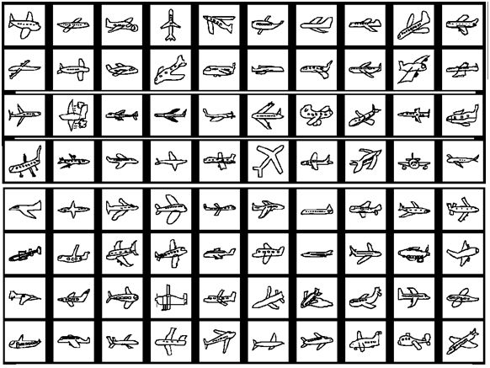
Benchmark (4/5)
2D Sketch Dataset
Selected 7200 sketches (90 classes, each with 80 sketches), which have relevant models in PSB [SMKF04], from [EHA12].
One example indicating the variations within one class:

Slide 11
Benchmark (5/5)
3D Model Dataset
Built on the Princeton Shape Benchmark (PSB) dataset [SMKF04].
The target 3D model dataset comprises 1258 selected models distributed on 90 classes.
Corresponding classes and models in PSB:
Notes:
Explain Table A.

Slide 12
Outline
Contributors
Introduction
Benchmark
Methods
Evaluation
Results
Conclusions and Future Work

Slide 13
Methods
Fourier spectra from silhouette, contour, and edge images (EFSD)
Sketch-based 3D model retrieval based on 2D-3D alignment and shape context matching (SBR-2D-3D)
Sketch-based 3D model retrieval based on view clustering and shape context matching (SBR-VC)
Fourier descriptors on 3D model silhouettes (FDC)

Slide 14
Fourier Spectra from Silhouette, Contour, and Edge Images (EFSD)
M. Aono, S. Tashiro
Toyohashi University of Technology, Japan

Slide 15
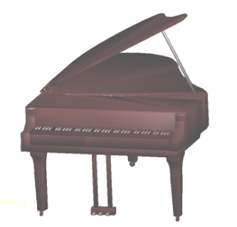
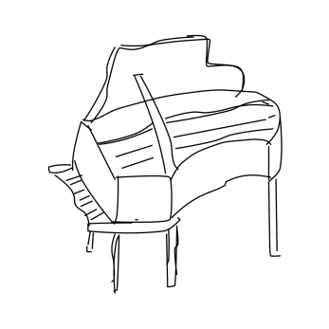
1st Stage of EFSD (Edge-based Fourier Spectra Descriptor)
Contour
Extraction
Binarization
Rendering from 3D,
Sketch, or Picture
(a) Silhouette
(b) Contour
Edge Extraction
(c) Edge
Notes:
In the first stage of EFSD (Edge-based Fourier Spectra Descriptor), (a) Silhouette image is generated by binarizing the input image.
During this process they assume there is a closed shape inside the image.
Thus, if there is only a 2D shape not enclosed with a closed curve, they may end up with no meaningful silhouette image.
2D sketch, for instance, might have an open curve. (b) Contour image is computed from Silhouette image
by extracting the enclosed contour. The same problem might arise when the 2D sketch has no closed curve.
(c) Edge image, on the other hand, is generated directly from given 2D image by applying Laplacian edge filter.

Slide 16
2nd Stage of EFSD
(a)
(b)
(c)
Polar Coordinate
Fourier Spectrum
Notes:
After three independent images (a), (b), and (c) are obtained, they transform them into polar coordinate to attempt to absorb the rotational variance.
This is because the rotation in Cartesian coordinate system will be the translation in polar coordinate system, which is absorbed in Fourier transform in the last phase. The feature vector of their model is defined by combining theses three Fourier spectra.

Slide 17
Sketch-Based 3D Model Retrieval Based on 2D-3D Alignment and Shape Context Matching (SBR-2D-3D)
Bo Li¹, Yijuan Lu¹, Henry Johan²
¹ Texas State University, USA
² Fraunhofer IDM@NTU, Singapore

Slide 18
Introduction
Main Idea of the SBR-2D-3D [LJ12]:
Maximizing the chances of selecting the most similar sample views of a 3D model to compare with a 2D sketch;
While not adding additional online computation and avoiding the brute-force comparison between the sketch and many sample views.
Approach:
2D-3D alignment: shortlist a set of candidate views for each model according to their top View Context similarities as the sketch.
View Context [LJ10]: a 3D model feature which has a capability of differentiating different sample views of a 3D model.
2D-3D matching: shape context matching [BMP02].
[LJ12] LI B., JOHAN H.: Sketch-based 3D model retrieval by incorporating 2D-3D alignment. Multimedia Tools and Applications (2012), 1–23 (online first version).
[LJ10] LI B., JOHAN H.: View context: A 3D model feature for retrieval. In: S. Boll et al. (eds.): MMM 2010, LNCS, Springer, Heidelberg 5916 (2010), 185–195.
[BMP02] BELONGIE S., MALIK J., PUZICHA J.: Shape matching and object recognition using shape contexts. IEEE Trans. Pattern Anal. Mach. Intell. 24, 4 (2002), 509–522.
Notes:
Main Idea of the sketch-based retrieval algorithm [LJ12]:
Maximizing the chances of selecting the most similar sample views of a 3D model to compare with a 2D sketch;
While not adding additional online computation and avoiding the brute-force comparison between the sketch and many sample views.
Approach:
Online retrieval: for each model, a set of candidate views are efficiently shortlisted according to their top View Context similarities as the sketch.
Utilizing a 3D model feature named View Context [LJ10], which has a capability of differentiating different sample views of a 3D model
Shape context matching [BMP02] algorithm is employed to compute the distances between the query sketch and the candidate sample views.
Two stages: precomputation and online retrieval

Slide 19
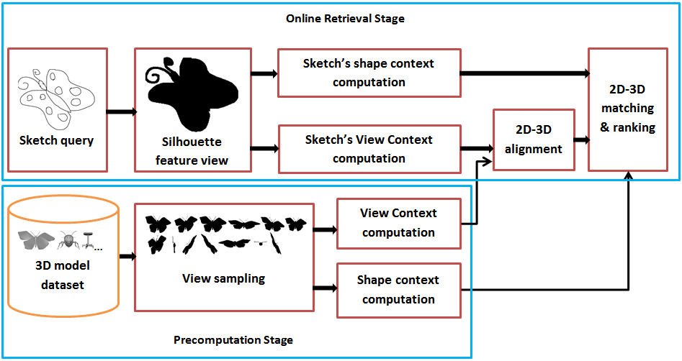
Flowchart
Notes:
The algorithm contains two stages: precomputation and online retrieval.
During the precomputation stage, we first sample 13 silhouette views for each target model, and then precompute the View Context and shape context features for each sample view.
During online retrieval, we first generate a silhouette view for each sketch, and then compute its shape context and View Context features. Based on the View Context features of the sketch and sample views, we perform 2D-3D alignment by finding the sample views with top View Context correlation similarities as the sketch. Finally, we perform shape context matching between the sketch and the shortlisted sample views and regard the minimum 2D-3D matching distance as the sketch-model distance.

Slide 20
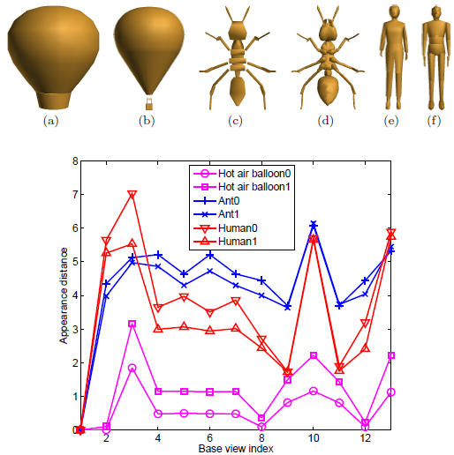
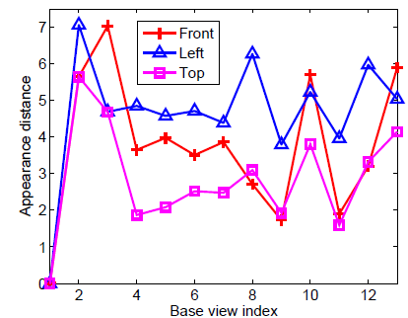
View Context
An example indicating that View Contexts of different views of the same model are also often different. The View Contexts of the front, left and top views of the model Human 0 (figure (e)) are shown.
View Contexts of six models: (a) Hot air balloon 0; (b) Hot air balloon 1; (c) Ant 0; (d) Ant 1; (e) Human 0; (f) Human 1; (g) Views context plots. View Contexts of different types of models are usually different.
Notes:
In this slide, we give some details about View Context.
View Context is defined as the visual information differences between the current view and each view in the base view set. It measures the shape appearance deviation feature of a 3D model with respect to a set of base views.
Left Figure: View Context examples of different models
Right Figure: View Context examples of the same model

Slide 21
Sketch-Based 3D Model Retrieval Based on View Clustering and Shape Context Matching (SBR-VC)
Bo Li¹, Yijuan Lu¹, Henry Johan²
¹ Texas State University, USA
² Fraunhofer IDM@NTU, Singapore

Slide 22
Introduction
Motivation: 3D models often differ in their visual complexities, thus there is no need to sample the same number of views to represent each model.
SBR-VC [LLJ13]: Sketch-Based Retrieval algorithm based on adaptive View Clustering and Shape Context matching, has been proposed.
Visual complexity metric: viewpoint entropy distribution of a set of sample views of a model.
Use to decide the number of the representative views of the 3D model.
FCM view clustering: Fuzzy C-Means view clustering on the sample views based on their viewpoint entropy values and viewpoint locations.
2D-3D matching: shape context matching [BMP02] between a query sketch and the representative views for each target model.
[LLJ13] LI B., LU Y., JOHAN H. Sketch-Based 3D Model Retrieval by Viewpoint Entropy-Based Adaptive View Clustering. 3DOR 2013, Accepted, May, 2013.
[BMP02] BELONGIE S., MALIK J., PUZICHA J.: Shape matching and object recognition using shape contexts. IEEE Trans. Pattern Anal. Mach. Intell. 24, 4 (2002), 509–522.
Notes:
Motivation: 3D models often differ in their visual complexities, thus there is no need to sample the same number of views to represent each model.
A Sketch-Based Retrieval algorithm based on adaptive View Clustering and Shape Context matching, named SBR-VC, has been proposed.
Visual complexity metric: viewpoint entropy distribution of a set of sample views of a model.
Based on Visual complexity metric the number of the representative views of the 3D model is adaptively assigned.
Then, a Fuzzy C-Means view clustering is performed on the sample views based on their viewpoint entropy values and viewpoint locations.
Finally, shape context matching [BMP02] is utilized during online retrieval for the matching between a query sketch and the representative views for each target model.
Two stages: precomputation and online retrieval

Slide 23
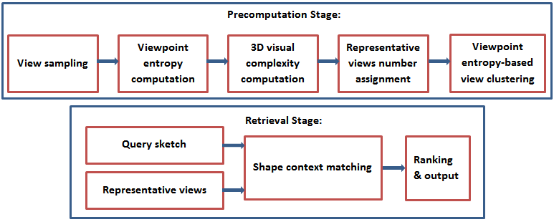
Overview
An overview of the SBR-VC algorithm.
Notes:
An overview of the algorithm is shown in the figure. It comprises Two stages: precomputation and online retrieval.
In the course of precompuation stage, for each 3D model, we first uniformly sample a set of view locations, and compute their viewpoint entropies, based on which we compute the visual complexity of the model. Based on the visual complexity value, we assign the number of clusters when performing fuzzy c-means view clustering on the sample views of the model.
During the online retrieval stage, we compare the query sketch with each representative view based on shape context matching and regard the minimum distance as the final 2D-3D distance.

Slide 24
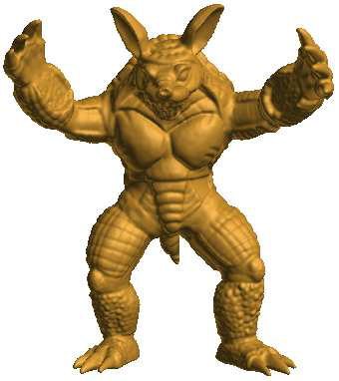
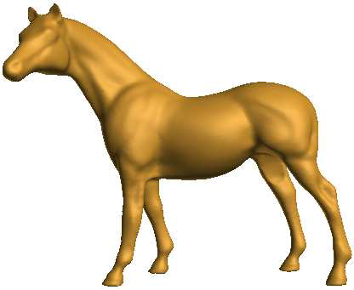
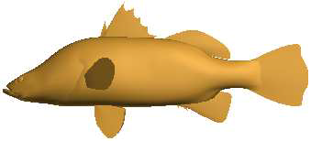
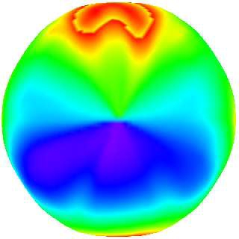
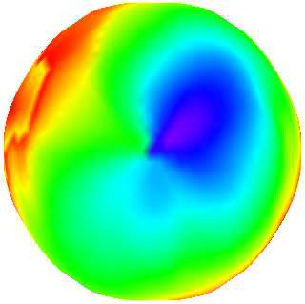
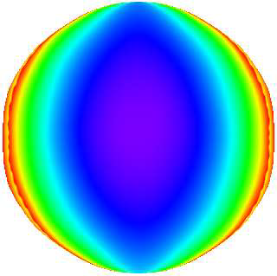
Viewpoint Entropy-Based Adaptive View Clustering
Step 1. Viewpoint Entropy Distribution.
Subdivide a regular icosahedron (denoted as L0) n times based on the Loop subdivision algorithm and name the resulting shape as Ln.
For each model, sample a set of viewpoints by setting the cameras on the vertices of Ln. and then compute their viewpoint entropy values.
Notes:
It can be seen that for a 3D model, the complexity of its entropy distribution
pattern is highly related to the complexity of its geometry. For instance, the two complex models armadillo and horse have
a more complicated pattern than the relatively simpler model fish.

Slide 25
Viewpoint Entropy-Based Adaptive View Clustering
Step 2. Viewpoint Entropy-Based 3D Visual Complexity.
The visual complexity metric is defined based on a class-level entropy distribution analysis on a 3D dataset.
3D visual complexity C is defined as follows,
where, and are the normalized standard deviation entropy value s and mean value m by their respective maximums over all the classes.
The metric is capable of reasonably reflecting the semantic distances among different classes of models. Example.
Step 3. Viewpoint Entropy-Based FCM Adaptive Views Clustering.
Utilizing C, assign the number of representative feature views N_{c} :
is the total number of sample views in the algorithm.
Notes:
Step 2. Viewpoint Entropy-Based 3D Visual Complexity.
The visual complexity metric is defined based on a class-level entropy distribution analysis on a 3D dataset.
Mean and standard deviation entropy values m and s among all the sample views of a 3D model are first computed, followed by an average over all the models for each class. 3D visual complexity C is defined as follows,
where, s_bar and m_bar are the normalized s and m by their respective maximums over all the classes.
The metric is capable of reasonably reflecting the semantic distances among different classes of models.
Step 3. Viewpoint Entropy-Based FCM Adaptive Views Clustering.
Utilizing the visual complexity value C of a model, the number of representative outline feature views N_{c} is adaptively assigned:

Slide 26
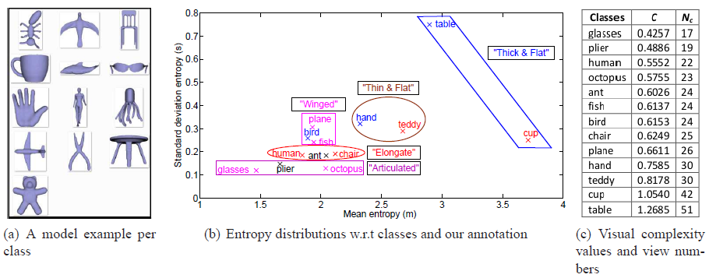
Viewpoint Entropy-Based Adaptive View Clustering
Viewpoint entropy distributions and numbers of representative views of different classes in the WMB 3D benchmark
Back
Notes:
As an example, we select the Watertight 3D Model Benchmark (WMB).
It comprises 13 selected classes, 260 models, 20 each. One sample from each class is shown in Figure (a).
Figure (b) shows the entropy distributions of different classes and the analysis of our clustering results.
As shown in the figure, viewpoint entropy reasonably reflects the semantic distances among different classes.
For example, “bird”, “plane” and “fish” all have “wings” and are also visually similar.
“Human”, “ant” and “chair” share the characteristic of elongate shapes. So on so forth.
Figure (c) sorts and lists the 3D visual complexity values of the 13 classes.

Slide 27
Fourier Descriptors on 3D Model Silhouettes (FDC)
Jose M. Saavedra
ORAND S.A., Chile
DCC- University of Chile, Chile

Slide 28
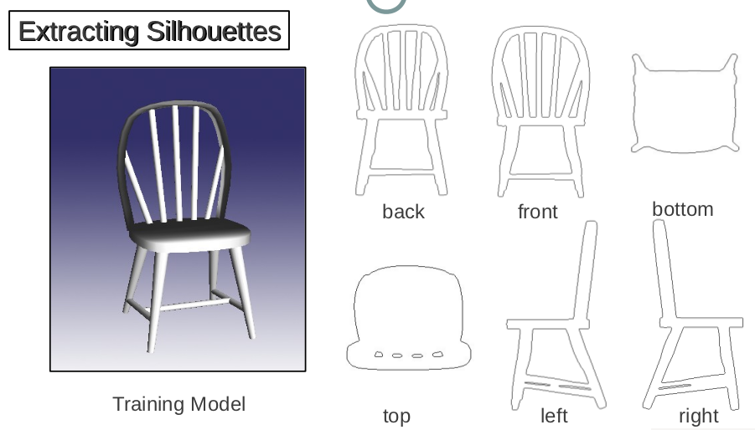
Extracting Silhouettes

Slide 29
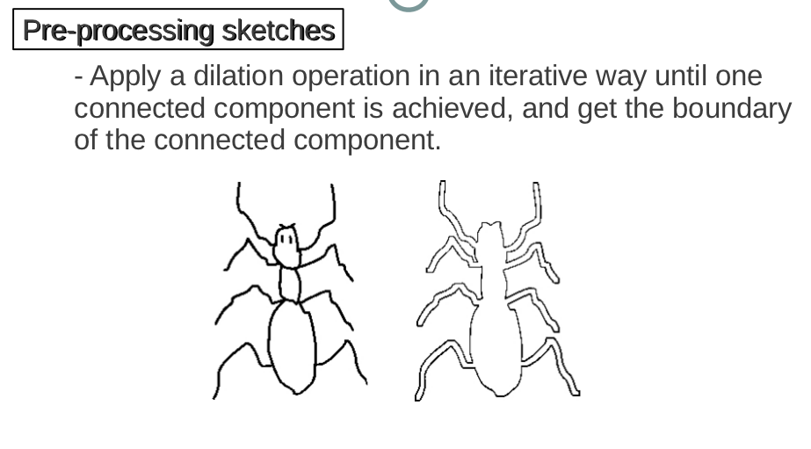
Pre-processing sketches

Slide 30
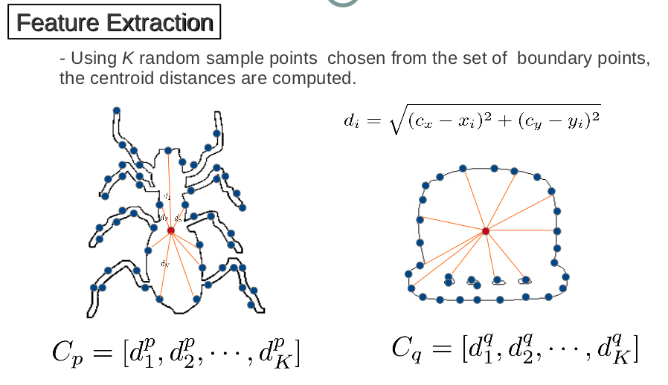
Feature Extraction

Slide 31
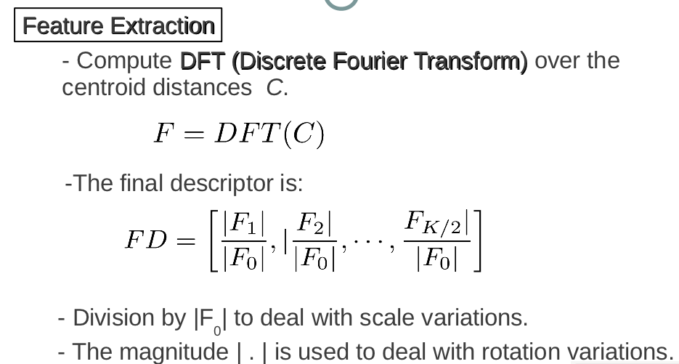
Feature Extraction

Slide 32
Similarity Measure

Slide 33
Outline
Contributors
Introduction
Benchmark
Methods
Evaluation
Results
Conclusions and Future Work

Slide 34
Evaluation
Seven commonly adopted performance metrics in 3D model retrieval technique:
Precision-Recall plot (PR)
Nearest Neighbor (NN)
First Tier (FT)
Second Tier (ST)
E-Measures (E)
Discounted Cumulated Gain (DCG)
Average Precision (AP)
We also have developed the code to compute them
http://www.itl.nist.gov/iad/vug/sharp/contest/2013/SBR/data.html

Slide 35
Outline
Contributors
Introduction
Benchmark
Methods
Evaluation
Results
Conclusions and Future Work

Slide 36
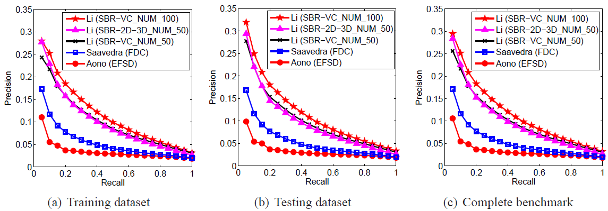
Results: Precision-Recall
Precision-Recall diagram performance comparisons on different datasets of the SHREC’13 Sketch Track Benchmark for the 5 runs of the 4 participating methods.
Notes:
First is the Precision-Recall plots.
There are training, testing and complete datasets in the benchmark.
Their performances are shown in the three subfigures respectively.
Li’s SBR-VC performs best, closely followed by Li’s SBR-2D-3D . Performance of the remaining two methods is relatively lower.

Slide 37
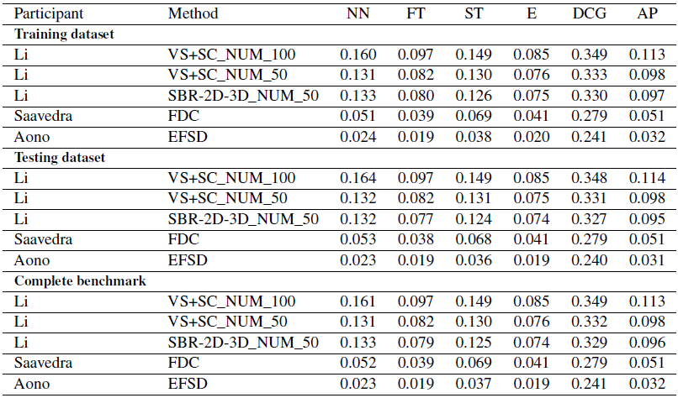
Results: Performance Metrics
Performance metrics for the performance comparison on the SHREC’13 Sketch Track Benchmark

Slide 38
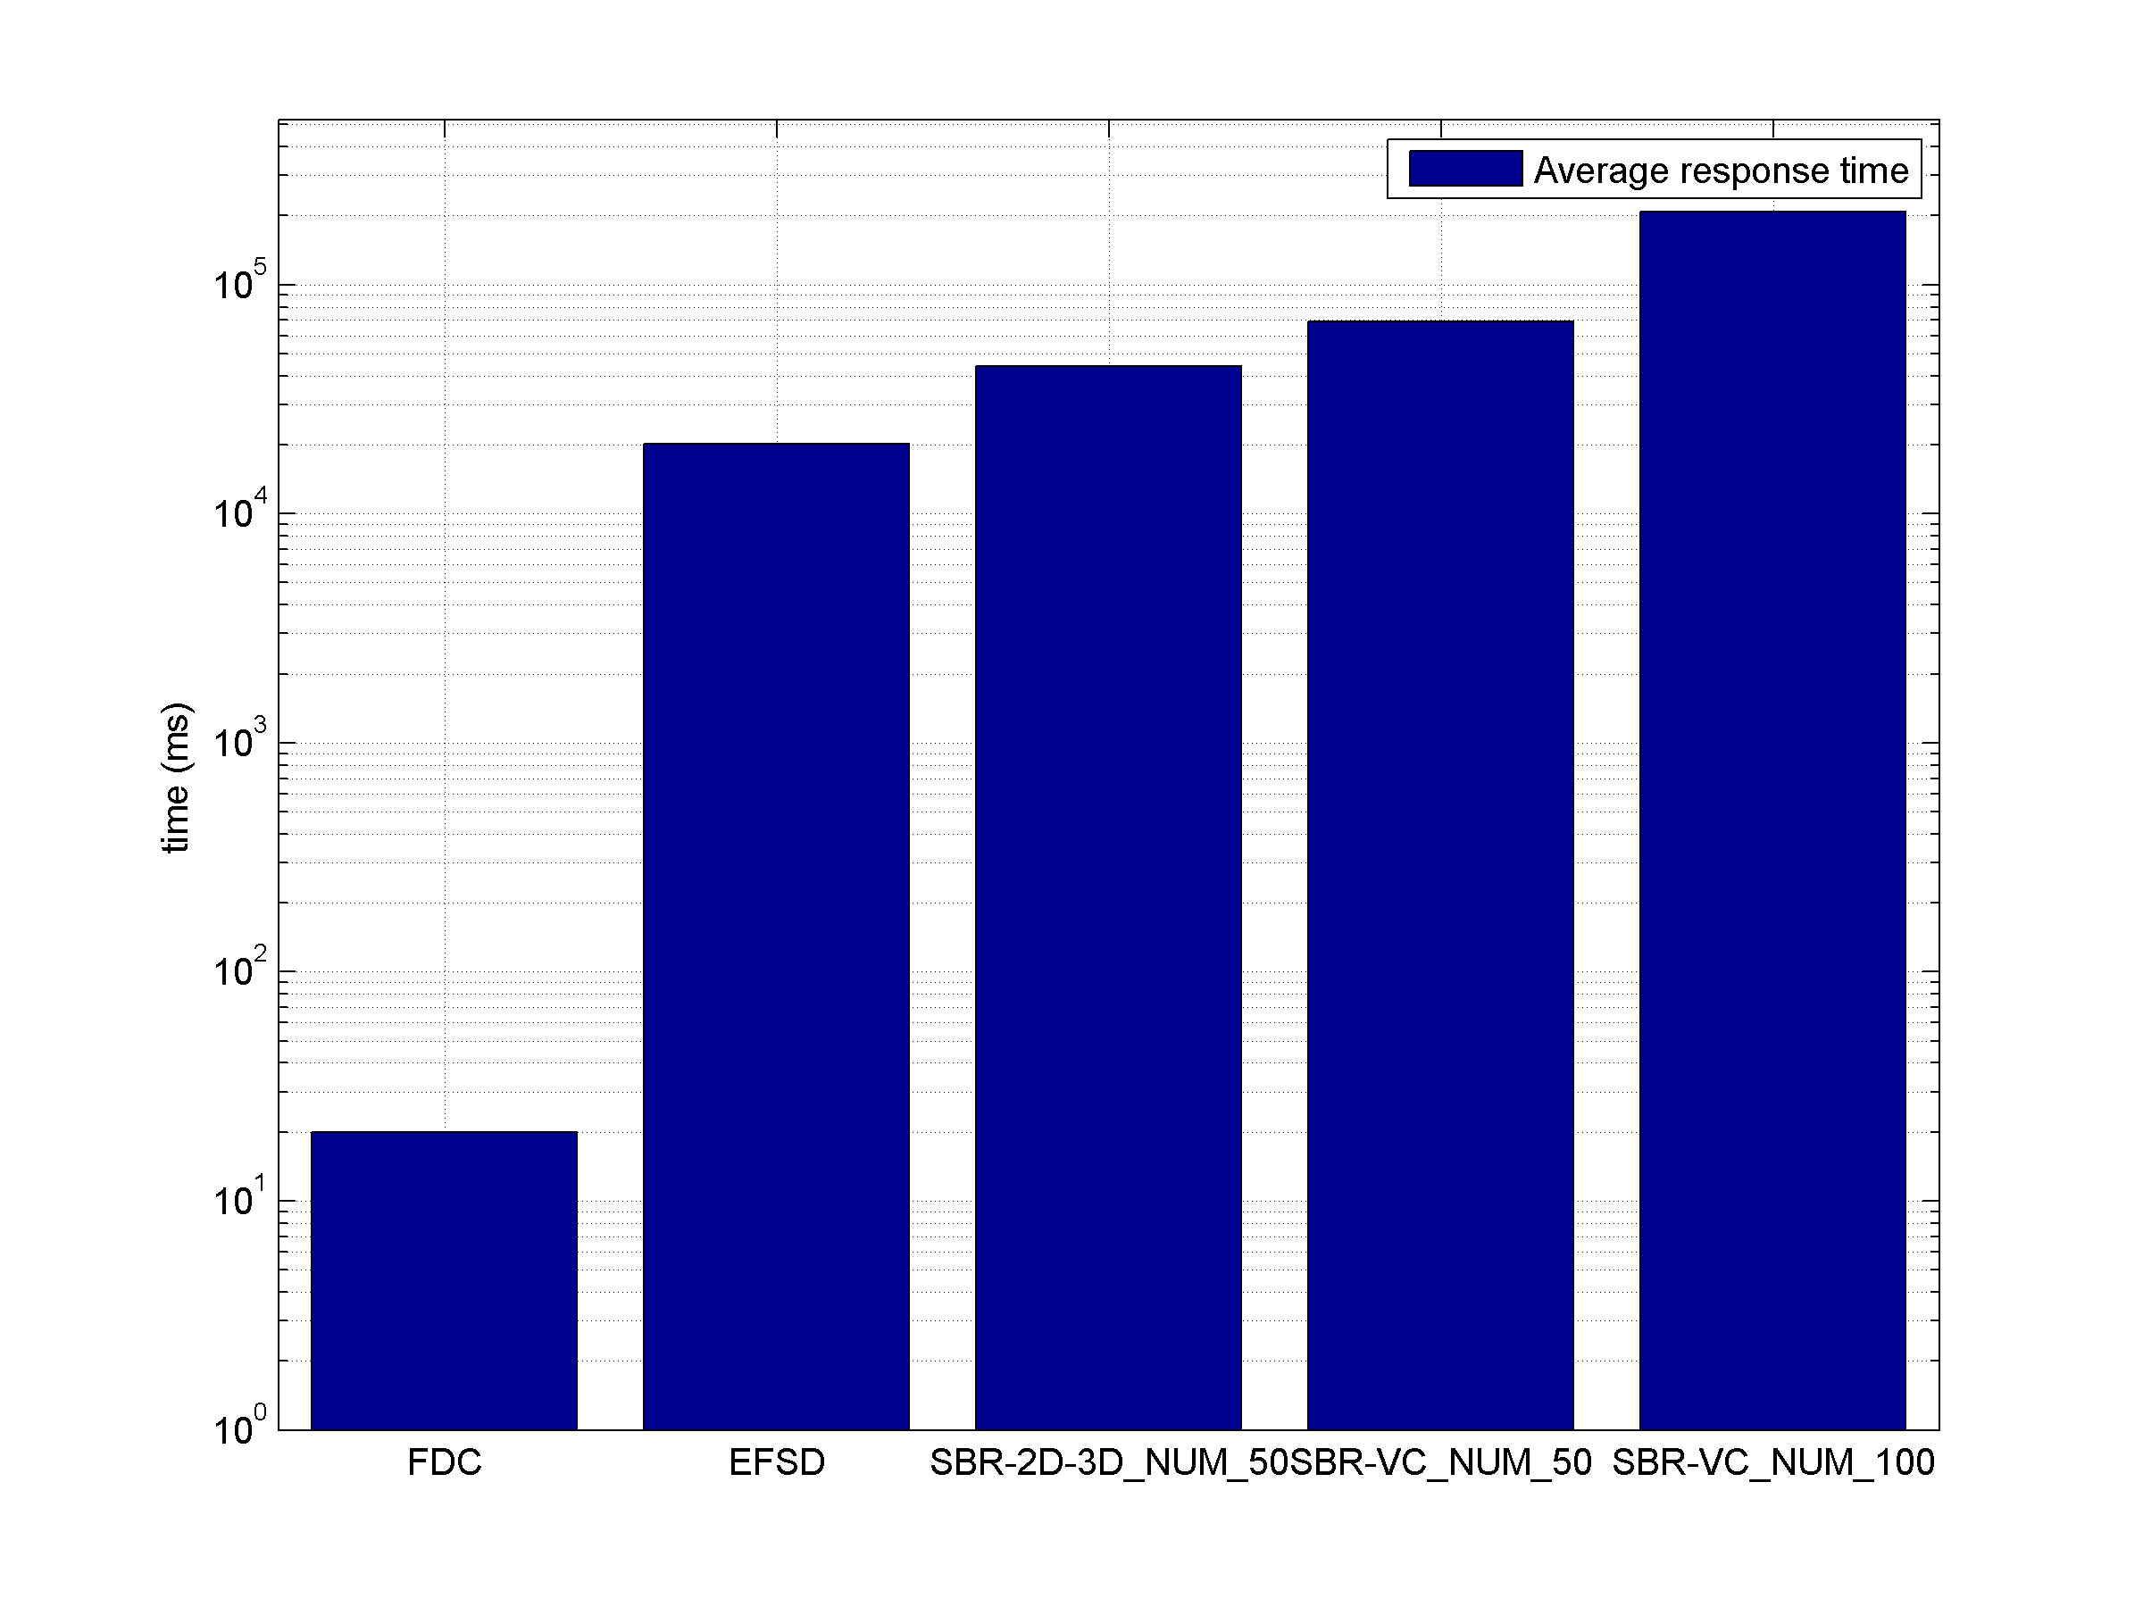
Results: Timing
Average response time per query on the “Testing” dataset.
Notes:
Then, we asked participants to also provide timing information to compare runtime requirements of their methods, based on the testing dataset.
The average response time for a query ranges from 0.02 seconds (FDC) to 208.85 seconds (SBR-VC_NUM_100).
Overall, FDC is the most efficient. Other approaches are much slower.

Slide 39
Results: Evaluation and Analysis
Overall performance evaluation:
Li’s SBR-VC performs best, closely followed by Li’s SBR-2D-3D.
Compared to [LSG*12], SBR-2D-3D is less successful.
Performance of the remaining two methods is relatively lower.
Analysis: all the retrieval performance metrics values are not high. Mainly due to the challenges of the benchmark:
Many variations of an object add the difficulty for accurate retrieval and deserves more robust retrieval algorithms.
Bias in the target class still exists.
Large variation in the number of models in different classes makes it difficult to retrieve those models. One example (next slide)
[LSG∗12] LI B., et al.,: SHREC’12 track: Sketch-based 3D shape retrieval. In 3DOR (2012), Spagnuolo M., Bronstein M. M., Bronstein A. M., Ferreira A., (Eds.), Eurographics Association, pp. 109–118.
Notes:
Overall performance evaluation:
Li’s SBR-VC performs best, closely followed by Li’s SBR-2D-3D.
Compared to the performance obtained in the SHREC’12 sketch-based 3D model retrieval track [LSG12] which employed a much smaller benchmark, the performance of SBR-2D-3D is less successful.
Performance of the remaining two methods is apparently lower.
Analysis: all the retrieval performance metrics values are not high, which is mainly due to the challenges of the benchmark:
Many variations of an object add the difficulty for accurate retrieval and deserves a higher standard on the robustness of retrieval algorithms.
Though the query class bias has been solved, the bias in the target class still exists.
There is a large variation in the number of models in different classes. To accurately retrieve these classes of models in the First Tier and Second Tier is difficult. Therefore, their performance metrics values, especially on NN, FT and ST, are relatively much lower. One example:

Slide 40
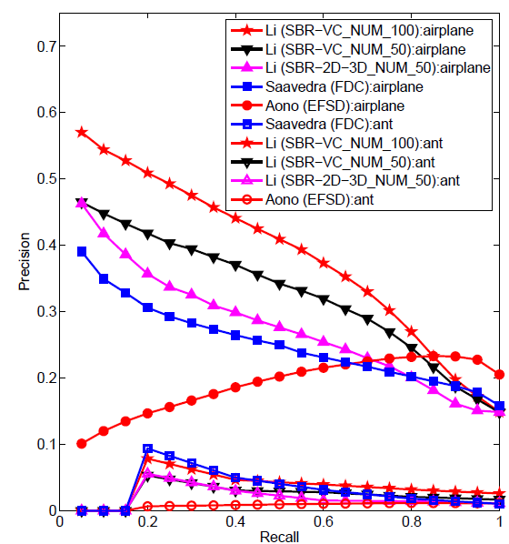
Precision-Recall diagram performance comparisons on the “airplane” and “ant” classes of the SHREC’13 Sketch Track Benchmark for the 4 participating methods.
The “airplane” class contains 184 target models while the “ant” class only has 5 models.

Slide 41
Outline
Contributors
Introduction
Benchmark
Methods
Evaluation
Results
Conclusions and Future Work

Slide 42
Conclusions (1/3)
Build a large scale sketch-based retrieval benchmark
Perform a comprehensive comparative evaluation of four SBR methods.
Performance:
Li’s SBR-VC method performs best, closely followed by Li’s SBR-2D-3D approach.
Similar parts: view selection-> shape context global feature matching
Both Saavedra’s FDC and Aono’s EFSD methods are based on Fourier descriptors; have inferior performance; FDC outperforms EFSC.
Timing:
FDC is the fastest, followed by EFSD.
Both outperform either SBR-VC or SBR- 2D-3D on this aspect.
Notes:
Performed a comprehensive comparative evaluation of 4 sketch-based retrieval methods.
Li’s SBR-VC method performs best, closely followed by Li’s SBR-2D-3D approach. Both perform view selection, extract shape context features and utilize global shape matching.
Both Saavedra’s FDC and Aono’s EFSD methods are based on Fourier descriptors; and achieve inferior performance compared to the top two; while FDC outperforms EFSC.
However, FDC is the fastest, followed by EFSD. Both outperform either SBR-VC or SBR- 2D-3D on this aspect.

Slide 43
Conclusions (2/3)
The retrieval performance, either accuracy or efficiency, is far from satisfactory.
Performance of existing sketch-based retrieval algorithms drop apparently when scaled to a large collection.
Future direction: robust and efficient algorithms scalable to different sizes and types of sketches and models.
Recommendation: utilizing knowledge and techniques from other related disciplines:
Pattern recognition
Machine learning
Computer vision
Notes:
Generally the retrieval performance, either in terms of accuracy or efficiency, is far from satisfactory.
Performance of existing sketch-based retrieval algorithms drop apparently when scaled to a large collection.
Future direction is developing robust and efficient algorithms which are scalable to different sizes and types of sketch queries and models.
Recommendation: utilizing knowledge and techniques from other related disciplines, such as pattern recognition, machine learning, and computer vision.

Slide 44
Conclusions (3/3)
An attempt to further foster this challenging and interesting research direction.
Though challenging, 3 groups successfully participated in the track and contributed 5 runs of 4 methods.
Provided a common platform to solicit current approaches in terms of this large scale retrieval scenario.
The large scale sketch retrieval benchmark will become a useful reference for this community.
Notes:
This large scale sketch-based retrieval track is an attempt to further foster this challenging and interesting research direction encouraged by the success of SHREC’12 Sketch-based 3D shape retrieval track.
Though the benchmark is very challenging, we still have 3 groups who have successfully participated in the track and they have contributed 5 runs of 4 methods.
Provided a common platform to solicit current sketch-based 3D model retrieval approaches in terms of this large scale retrieval scenario.
Hope the large scale sketch retrieval benchmark become a useful reference for researchers in this community.

Slide 45
Future Work
Extend to a more representative benchmark by
Making each class of the target 3D model dataset contain the same number of models.
Remove the remaining bias in the target dataset.

Slide 46
Acknowledgement
This work of Bo Li and Yijuan Lu is supported by the Texas State University Research Enhancement Program (REP), Army Research Office grant W911NF-12-1-0057, and NSF CRI 1058724 to Dr. Yijuan Lu.
The work of Afzal Godil is supported by the Shape Metrology IMS.
We would like to thank Mathias Eitz, James Hays and Marc Alexa who collected the sketches; as well as Philip Shilane, Patrick Min, Michael M. Kazhdan, Thomas A. Funkhouser who built the Princeton Shape Benchmark.

Slide 47
Thank you!
Any Questions?

