Slide 1











SHREC’12 TRACK: Sketch-Based 3D Shape Retrieval
B. Li, T. Schreck, A. Godil
M. Alexa, T. Boubekeur, B. Bustos, J. Chen, M. Eitz, T. Furuya, K. Hildebrand, S. Huang, H. Johan, A. Kuijper, R. Ohbuchi, R. Richter, J. M. Saavedra, M. Scherer, T. Yanagimachi, G. J. Yoon, S. M. Yoon

Slide 2
Contributors
Organizers:
Bo Li, Afzal Godil
National Institute of Standards and Technology, USA
Tobias Schreck
University of Konstanz, Germany
Participants:
Mathias Eitz, Ronald Richter, Kristian Hildebrand, Marc Alexa
  TU Berlin, Germany
  Tamy Boubekeur
  Telecom ParisTech/CNRS, France
  Bo Li, Henry Johan
  Nanyang Technological University, Singapore
Jose M. Saavedra, Benjamin Bustos
University of Chile, Chile
Tobias Schreck
University of Konstanz, Germany
Sang Min Yoon
Yonsei University, Korea
①
②
③

Slide 3
Contributors
Participants:
Tomohiro Yanagimachi, Jipeng Chen, Songhua Huang, Ryutarou Ohbuchi
University of Yamanashi
Takahiko Furuya
Nisca Corp., Japan
Sang Min Yoon
Yonsei University, Korea
Maximilian Scherer
GRIS, TU Darmstadt, Germany
Gang Joon Yoon
National Institute for Mathematical Science, Korea
Tobias Schreck
University of Konstanz, Germany
Arjan Kuijper
Fraunhofer IGD, Germany
④
⑤
Notes:
3

Slide 4
Motivation
Sketch-based 3D model retrieval is to retrieve 3D models using a 2D sketch as input.
This scheme is intuitive and convenient for users to search for relevant 3D models and also important for several applications including sketch-based modeling and sketch-based shape recognition.
Most existing 3D model retrieval algorithms target the Query-by-Model framework, that is, using existing 3D models as queries. Less work has to date considered the query-by-sketch framework.
We organized this track to foster this challenging research area by providing a common sketch-based retrieval benchmark and soliciting retrieval results from current state-of-the-art retrieval methods for comparison.

Slide 5
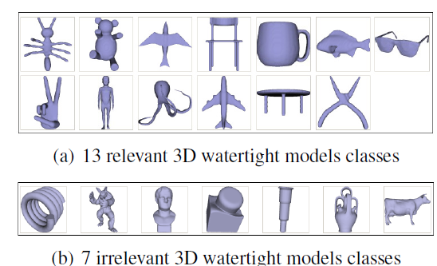
Data Set
3D Target Dataset
  Watertight Model Benchmark (WMB) dataset: 400 models, divided into 20 classes, with 20 models each
  Basic version: 13 relevant classes, 260 models
  Extended version: complete WMB dataset

Slide 6
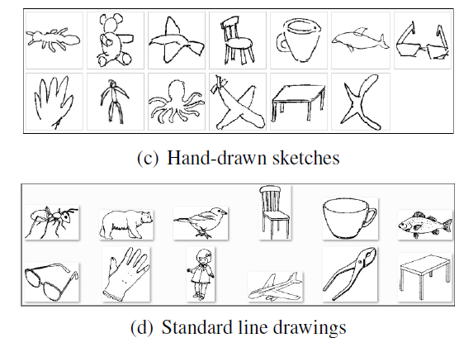
Data Set
2D Query Set
  Hand-drawn sketches: Hand-drawn sketch data compiled by TU Darmstadt and Fraunhofer IGD (250 sketches, 13 classes).
  Standard line drawings: 12 relevant sketches from the Snograss and Vanderwart’s standard line drawings dataset.

Slide 7
METHODS

Slide 8
Bag-of-Features 3D Shape Retrieval
1 1
Johan Mathias Eitz, Ronald Richter, Tamy Boubekeur, Kristian Hildebrand, Marc Alexa
  TU Berlin, Germany
  Telecom ParisTech/CNRS, France
2 1 1
1
2
Note: an extended version has been accepted to SIGGRAPH 2012

Slide 9
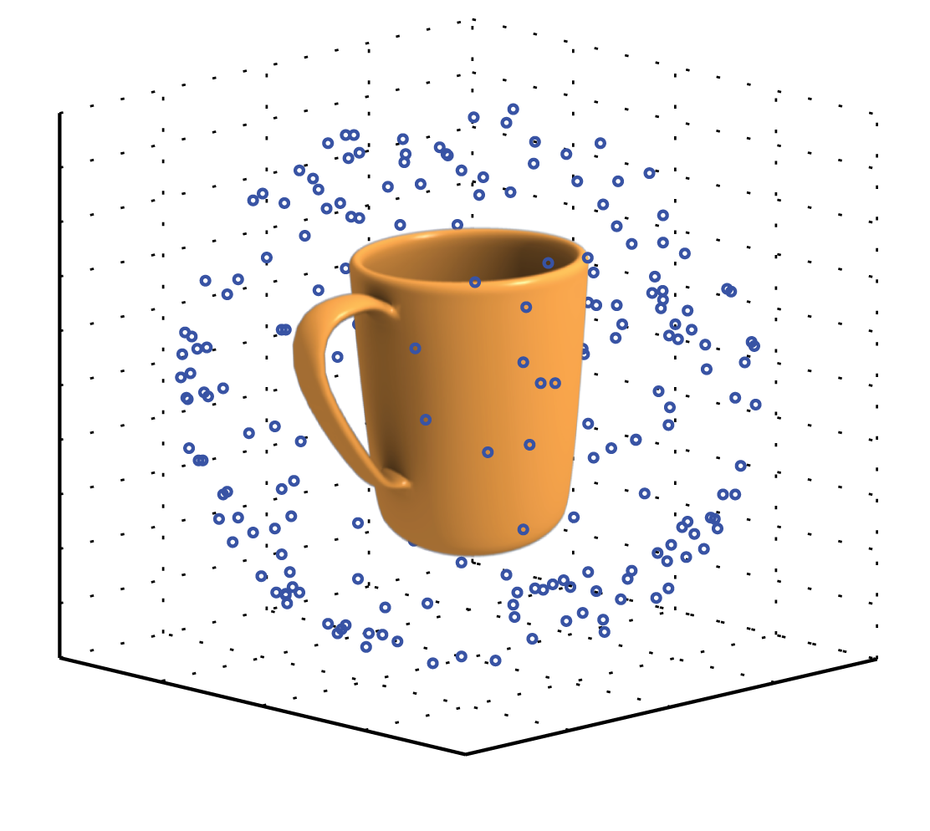
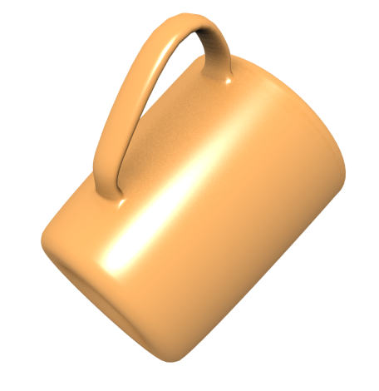
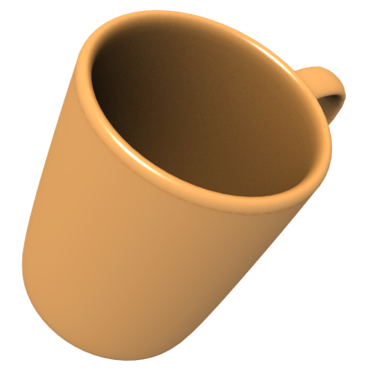
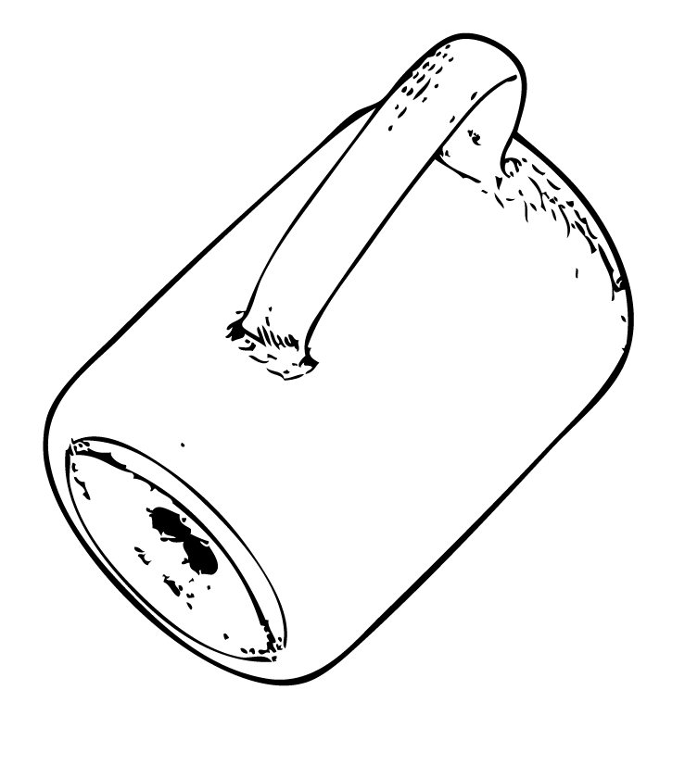

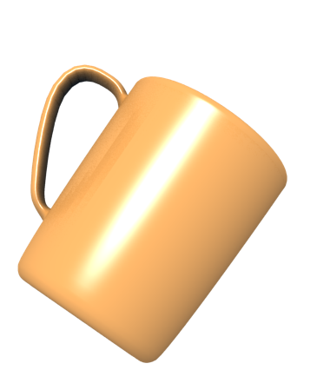
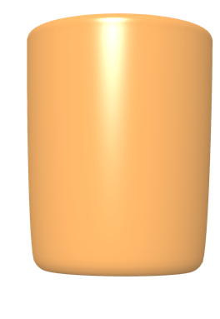
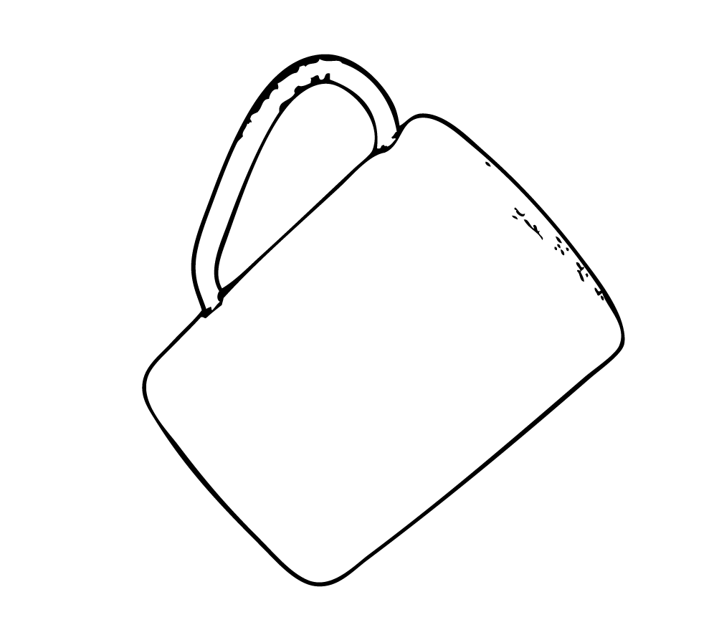
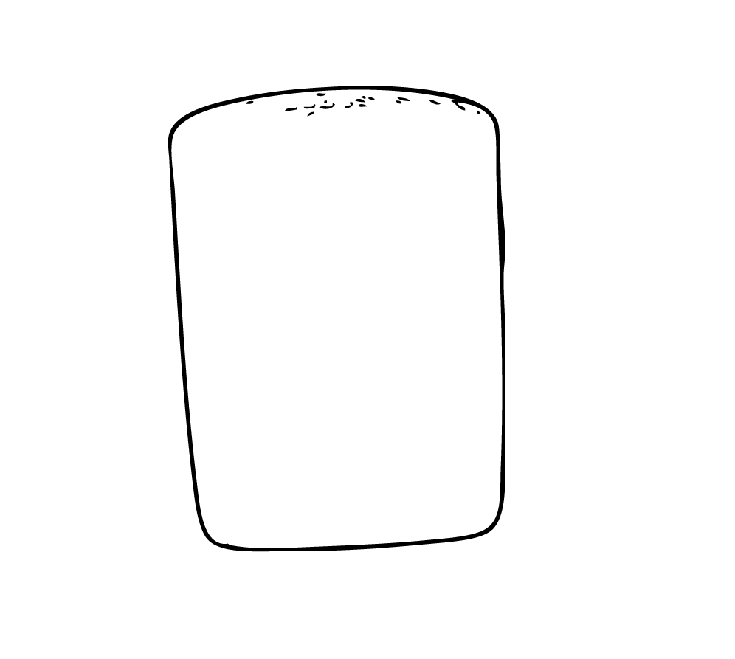
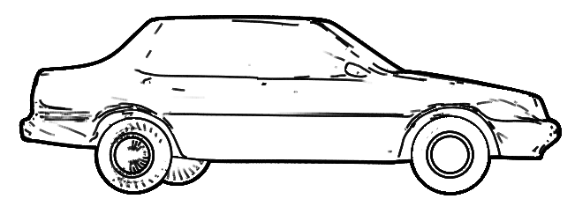
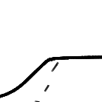



2D Views and Local Features
generate
...
render
...
...
...
...
...
Bag-of-features [Sivic’03]
Notes:
The first step of our approach (this is done in an offline preprocessing phase) is to represent each model in the collection as a set of views. We use 100 views in this setup and represent each view as a linedrawing rendered using suggestive contours.
Given a single view, we encode the view using a bag-of features approach. We extract many small local image areas from each view, as shown here. Together, all those small local areas represent a view. This approach – compared to global methods – has a several of advantages: it is translation invariant, as we do not store spatial location of features, it allows for partial matching and we can use standard search data structures from information retrieval to achieve quick lookup times.
On the next slide, I will explain how we further encode this representation.
So what we are doing is taking the mesh, creating a line drawing out of it and extracting a large set of local features (CLICK 5x). So what we are essentially doing is representing the mesh as a bag-of-features (CLICK). This approach – compared to global methods – has a bunch of advantages:
Translation Invariance (CLICK)
Partial Matching (CLICK)
And we can use standard search data structures from information retrieval

Slide 10

Local Features & Quantization
Given a local region
… we estimate orientations…
and encode their distribution
We use 4x4 spatial, 8 radial bins
quantize features against visual vocabulary
1
. . .
1
0
2
Notes:
Given a local image region, we estimate orientations using Gaussian derivatives and encode their distribution using 4x4 spatial bins and 8 radial bins. This representation is related to the SIFT descriptor but does not store direction of the gradients, as the only thing we can measure on a sketch is orientation.
Remember from the previous slide that we represented each view as a bag of local image regions. Each of those regions is actually encoded as an orientation histogram. We additionally quantize each feature against a visual vocabulary we generated in an offline training step. As the final representation of a sketch, we use a histogram of visual words: this histogram simply counts the frequency of each feature in a sketch.
On the next slide I will explain how we compute similarity between a sketch and a model using this representation.

Slide 11
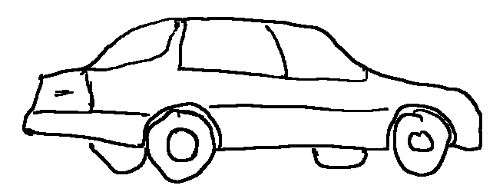
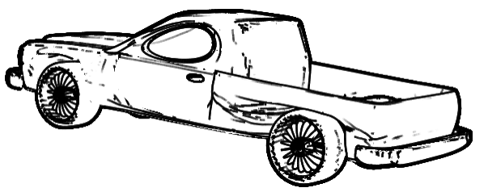
Similarity Based on Cosine Model
Similarity as angle in high-dimensional space
Similarity of
user sketch
and view
defined as
dot product between histograms
2
2
0
0
0
3
sim
7
6
,
3
0
0
0
,
0
0
3
2
Histograms are sparse: query is very fast (20 ms)
Notes:
We base our similarity measure on the well-known cosine model and define similarity as angle in high-dimensional space.
We define the similarity between a user sketch and a view as the dot product between their corresponding histograms. This operation is fast, as the histograms are typically very sparse. We additionally use an inverted index datastructure and as a result only need to compare against those view, that actually contain similar features as those in the query. For example, a query on the collection used in this benchmark takes only 20 ms (including extracting features out of the sketch).

Slide 12

Sketch-Based 3D Model Retrieval by Incorporating 2D-3D Alignment
Bo Li, Henry Johan
Nanyang Technological University

Slide 13
Algorithm Steps
Feature extraction
  Silhouette view
  Outline view
Feature distance
  ZFEC integrated image descriptor
Sketch’s View Context feature extraction
  Similar to a sample view’s View Context
2D-3D alignment
  Keep sample views with top View Context correlation similarities
Sketch-Model distance computation
  Relative shape context matching
Ranking and output
Notes:
Notes: Feature views and View Context will be presented in the following slide. This slides present the overall idea.

Slide 14
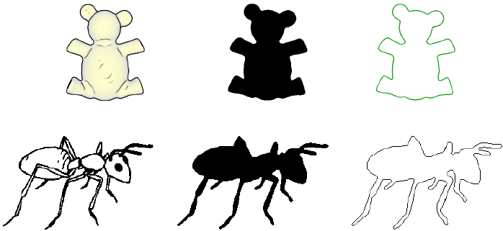
Feature Extraction Example
3D teddy model
silhouette view
outline view
2D ant standard line drawing
silhouette view
outline view

Slide 15
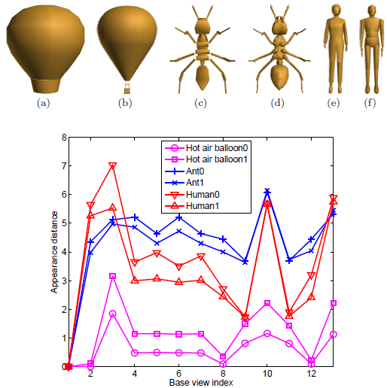
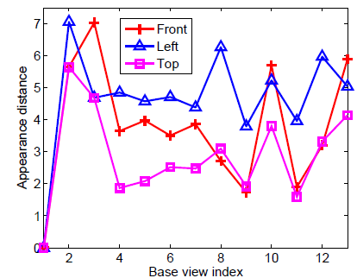
View Context
An example indicating that View Contexts of different views of the same model are also often different. The View Contexts of the front, left and top views of the model Human0 (figure (e)) are shown.
View Contexts of six models: (a) Hot air balloon0; (b) Hot air balloon1; (c) Ant0; (d) Ant1; (e) Human0; (f) Human1; (g) Views context plots. View Contexts of different types of models are usually different.
Notes:
Notes: View Context is defined as the visual information differences between the current view and each view in the base view set. It measures the shape appearance deviation feature of a 3D model with respect to a set of base views.
Left Figure: View Context examples of different models
Right Figure: View Context examples of the same model

Slide 16
HKO-KASD Approach
1 1 2 3 4
J. M. Saavedra, B. Bustos, T. Shreck, S. Yoon, M. Sherer
University of Chile, Chile
Universität Konstanz, Germany
Yonsei University, Korea
Technische Universität Darmstadt, Germany
1
2
3
4

Slide 17
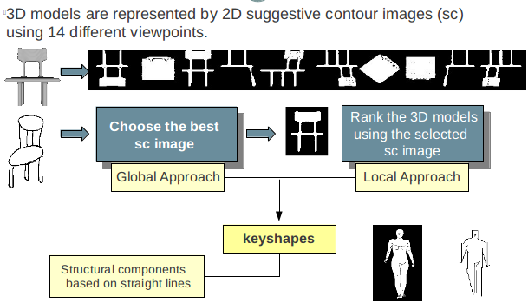
General Approach
Notes:
Notes:
Feature views: 14 suggestive contour images
Idea: First, use a Global Approach to determine the best suggestive contour view.
Next, use a Local shape descriptor to measure the distance between sketches or suggestive contour views

Slide 18
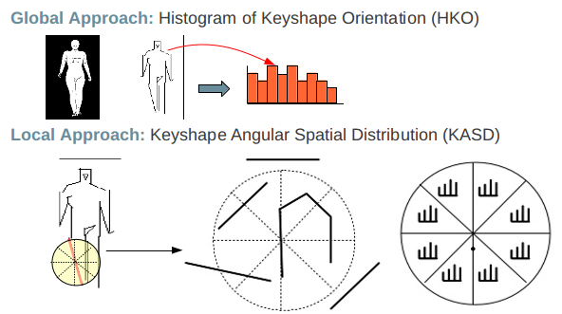
Global and Local Approach
Notes:
Notes: main ideas of the two approaches. ->Key Shape: histogram (global) and spatial distribution (local)

Slide 19
Visual Features on Silhouettes
1 1 1 2
T. Yanagimachi, J. Chen, S. Huang, T. Furuya,
R. Ohbuchi
University of Yamanashi, Japan
Nisca Corp., Japan
1
1
2

Slide 20



A Quick Hack
Compare by common denominator, i.e., silhouettes
  We did not anticipate watertight model…
Use whatever visual features we have
  Bag-of local features (BF-DSIFT, BF-GSIFT), and a global feature (IM-1SIFT) per view
A hack to turn sketches into silhouettes
  (Closing + filling) to convert (most) sketches to silhouettes
sketch
silhouette
closing
filling
Notes:
Notes: DSIFT: Dense SIFT
GSIFT: Grid SIFT
1SIFT: One SIFT
BF: Bag-of-Features

Slide 21




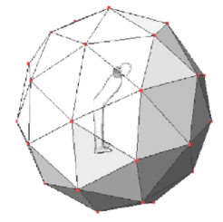


Visual Features on Silhouettes
Convert everything into silhouettes and compare
  Handle anything, e.g., polygon soup, point set, etc.
Sketch
DSIFT, etc. on silhouette
Dilation
Fillng
BOF
Minimum of distances among
42 image
pairs
feature
DSIFT, etc. on silhouette
View 1
BOF
Multi-view rendering
View1 feature
Pair-wise distance
3D model
View1 feature
…
…
…
…
View 42
View 42 feature
Notes:
Sketch: generate silhouette view first
Model: sample 42 views first

Slide 22
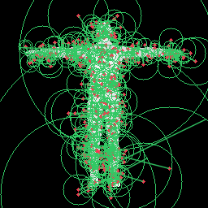

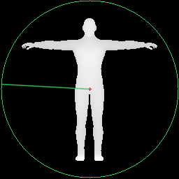
Visual Features on Silhouettes
Add distances from 3 features
  BF-DSIFT
    Hundreds of SIFT features per image, BoF integration
    Randomly placed with prior
  BF-GSIFT
    Hundreds of SIFT features per image
    Regularly placed grid sampling, BoF integration
    BoF integration
  IM-1SIFT
    A global SIFT feature per image
    Compare all the pairs, and take minimum
DSIFT
GSIFT
1SIFT

Slide 23
HOG_DTF from Suggestive Contour
1 2 3 2,4
S.M. Yoon, M. Scherer, T. Schreck, and A.Kuijper
Yonsei University, Korea
Technische Universität Darmstadt, Germany
Universität Konstanz, Germany
Fraunhofer IGD, Germany
1
2
3
4

Slide 24
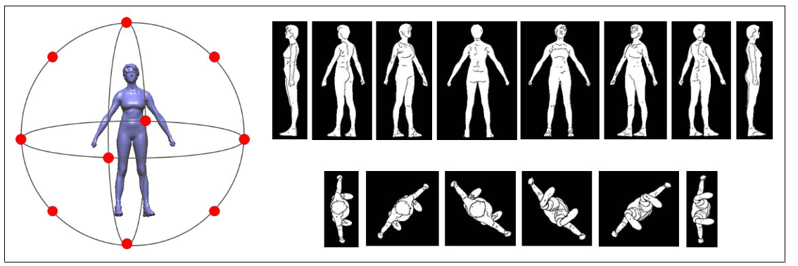
Suggestive Contour from 3D Mesh Model
Suggestive contour
  Provide more detailed information than boundaries, ridges and valleys
14 regularly rotated projected viewpoints from 3D model

Slide 25
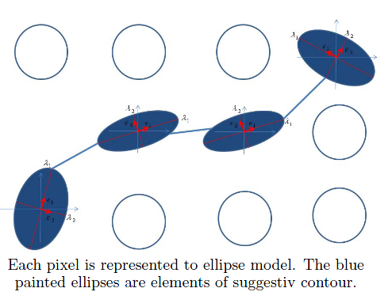
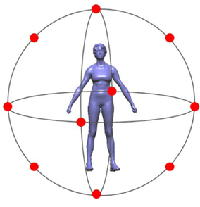
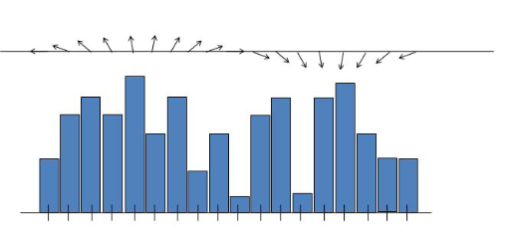
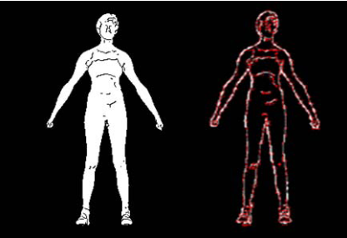
HOG-DTF Descriptor Extraction
Each suggestive contour pixel is represented as a 2D ellipsoidal model in the topological space of Diffusion Tensor Fields
  Normalize the feature vectors obtained from projected suggestive contours
  Represent as a Histogram of Oriented Gradient using the properties of diffusion tensor fields
  Robust against translation, rotation, and partial occlusions

Slide 26
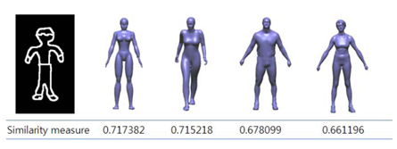
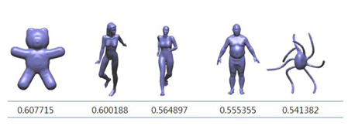
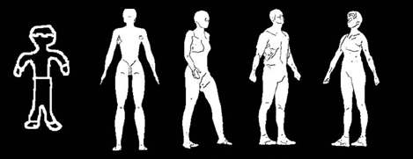
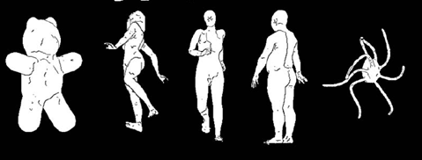
3D Model Retrieval
Retrieve the 3D models between the query image and view images of a 3D model
  Using Euclidean distance
  View-based 3D model retrieval provides top 3D models and their poses→ easy to understand user’s viewpoint of the query

Slide 27

Sparse Coding with HOG-DTF Features
1 2 3
S.M.Yoon, G.J.Yoon, T.Schreck
Yonsei Univerisity, Korea
National Institute for Mathematical Science, Korea
Universität Konstanz, Germany
1
2
3

Slide 28
HOG-DTF Descriptor from Suggestive Contour
Suggestive contour
  14 regularly rotated projected viewpoints from 3D models
HOG-DTF descriptor
  Histogram of Oriented Gradient features are extracted by analyzing the properties of suggestive contours

Slide 29
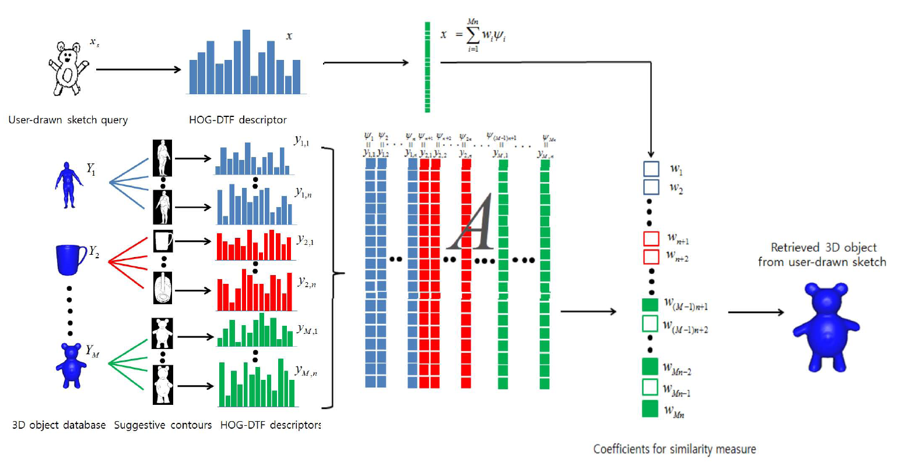
HOG-DTF Descriptor Factorization
Using Sparse Coding
Sparse coding
  HOG-DTF descriptor optimization as a linear combination of a small number of basis vectors
Notes:
Notes: (for understanding)
Sparse coding is the method of finding the optimal representation of input data
using a linear combination of an overcomplete trained dictionary basis with
sparse coefficients for extracting or preserving specific features.

Slide 30
Submissions
“BOF-SBR” by Mathias Eitz, Ronald Richter, Tamy Boubekeur, Kristian Hildebrand and Marc Alexa
“SBR-2D-3D” by Bo Li and Henry Johan
“HKO-KASD” by Jose M. Saavedra, Benjamin Bustos, Tobias Schreck and Sang Min Yoon
“Orig_DG1SIFT” and “Dilated_DG1SIFT” by Tomohiro Yanagimachi, Jipeng Chen, Songhua Huang, Takahiko Furuya and Ryutarou Ohbuchi
“HOG-DTF” and “HOG-SC” by Sang Min Yoon, Maximilian Scherer, Gang Joon Yoon, Tobias Schreck and Arjan Kuijper

Slide 31
Evaluation
Seven commonly adopted performance metrics in 3D model retrieval technique:
  Precision-Recall plot (PR)
  Nearest Neighbor (NN)
  First Tier (FT)
  Second Tier (ST)
  E-Measures (E)
  Discounted Cumulated Gain (DCG)
  Average Precision (AP)
We also have developed the code to compute them
  http://www.itl.nist.gov/iad/vug/sharp/contest/2012/SBR/

Slide 32
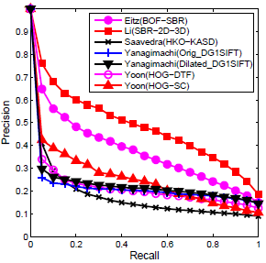
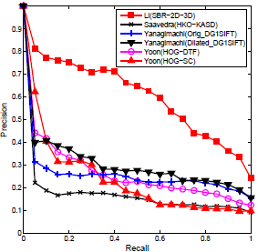
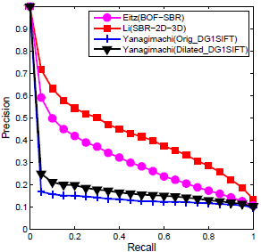
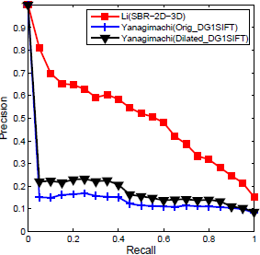
Results: Precision-Recall
(a) Hand-drawn sketch queries and Basic version of target dataset
(b) Standard line drawing queries and Basic version of target dataset
(c) Hand-drawn sketch queries and Extended version of target dataset
(d) Standard line drawings queries and Extended version of target dataset
Notes:
First is the Precision-Recall plots.
There are two versions of target dataset (Basic and Extended) as well as two types of sketch datasets (hand-drawn sketches and standard line drawings).
This results in four combinations: (a) Hand-drawn sketch queries and Basic version of target dataset; (b) Standard line drawing queries and Basic version of target dataset; (c) Hand-drawn sketch queries and Extended version of target dataset; (d) Standard line drawings queries and Extended version of target dataset.
Their performances are shown in the four subfigures respectively.
Li’s SBR-2D-3D performs best, closely followed by Eitz’s BOF-SBR. Performance of the remaining three methods is comparable and the disparity among them is relatively small.

Slide 33
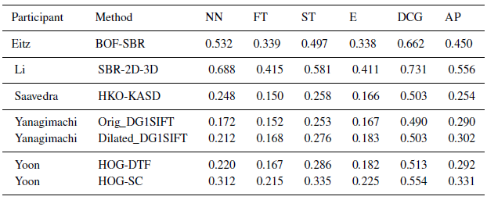
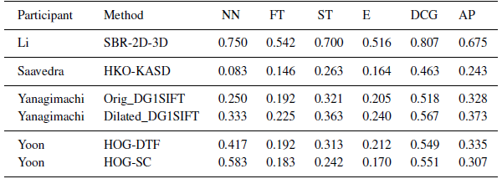
Results: Other Six Metrics
Table 1: Other Performance metrics for the performance comparison on the Hand-drawn sketch queries and Basic version of target dataset.
Table 2: Other Performance metrics for the performance comparison on the Standard line drawing queries and Basic version of target dataset.
Notes:
Then, comparisons of other six metrics.
Similar conclusion

Slide 34
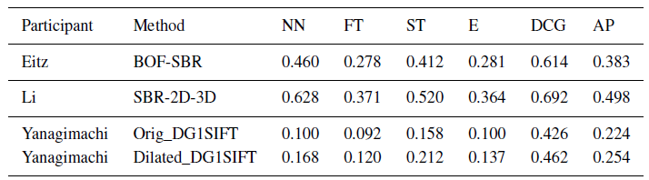
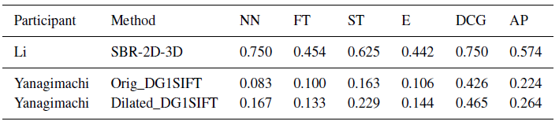
Results: Other Six Metrics (Cont.)
Table 3: Other Performance metrics for the performance comparison on the Hand-drawn sketch queries and Extended version of target dataset.
Table 4: Other Performance metrics for the performance comparison on the Standard line drawing queries and Extended version of target dataset.
Notes:
Continue
Similar conclusion

Slide 35
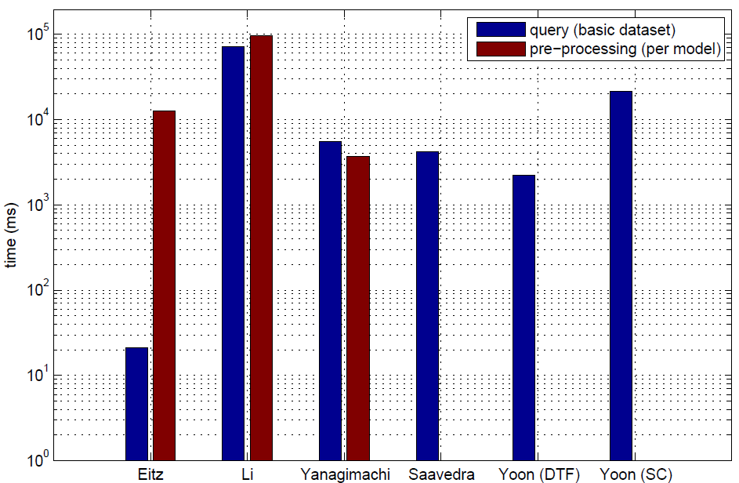
Results: Timing
Figure 2: Available timing information on the Hand-drawn sketch queries and Basic version of target dataset.
Notes:
Then, we asked participants to also provide timing information to compare runtime requirements of their methods, based on the first case (hand drawn-sketch queries and basic target dataset).
The average retrieval time for a query ranges from 0.02 seconds (Eitz) to 72.3 seconds (Li).
Overall, Eitz’s approach is the most efficient while Saavedra and Yangagimachi’s methods and Yoon’s HOG-DTF method are comparable.
Pre-processing times per model range from 3.73 seconds (Yanagimachi) to 97 seconds (Li).

Slide 36
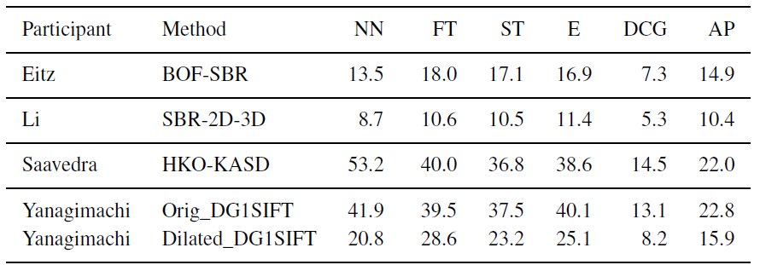
Results: Robustness
Table 5: Robustness performance comparison in terms of performance decrease (%) on the Hand-drawn sketch queries.
Notes:
Last, we evaluate the robustness of the different methods to irrelevant models in the dataset.
This table lists the percentage of performance decrease when using the extended target dataset instead of the basic one (using hand-
drawn sketch queries).
Li’s SBR-2D-3D is the most robust, closely followed by Eitz’s BOF-SBR.
Compared to these two approaches, the other three methods exhibit a stronger decrease in retrieval performance when adding irrelevant
models to the target dataset.

Slide 37
Results: Evaluation and Analysis
Overall performance evaluation: Li’s SBR-2D-3D performs best, closely followed by Eitz’s BOF-SBR. Performance of the remaining three methods is comparable and the disparity among them is relatively small.
Different types of queries: Compared to hand-drawn sketch queries, standard line drawing queries usually achieve superior performance.
Timing information: Overall, Eitz’s approach is the most efficient while Saavedra and Yangagimachi’s methods and Yoon’s HOG-DTF method are comparable. Pre-processing times per model range from 3.73 seconds (Yanagimachi) to 97 seconds (Li).
Robustness: Li’s SBR-2D-3D is the most robust, closely followed by Eitz’s BOF-SBR. Other 3 methods exhibit a stronger decrease in performance.
Classification:
  3 groups (Eitz, Saavedra and Yoon) utilize suggestive contours to extract 3D features.
  2 groups (Eitz and Yanagimachi) adopt a bag-of-words framework.
  3 groups (Eitz, Saavedra and Yanagimachi) employ local features while the other 2 groups (Li and Yoon) perform global feature matching.

Slide 38
Conclusions and Future Work
This sketch-based retrieval track is the first attempt to include this topic in SHREC in order to foster this challenging and interesting research direction.
Provide a common platform (the benchmark) to solicit current sketch-based 3D model retrieval approaches.
5 groups submitted 7 rank list results.
Evaluation measures: PR, NN, FT, ST,E, DCG, AP.

Slide 39
Conclusions and Future Work (Cont.)
A comprehensive comparative evaluation of 5 state-of-the-art sketch-based retrieval methods, in terms of accuracy, robustness and query types:
  Overall, Li’s SBR-2D-3D method performs best, closely followed by Eitz’s BOF-SBR approach while the remaining three methods perform comparably in terms of accuracy and robustness.
  Eitz’s method is extremely fast (0.02s per query) and could thus potentially be directly employed for interactive retrieval on much larger collections.
Future Work:
  Extend this benchmark by other sketch data to make it more representative.
  Controlling the level of standardization with respect to sketch parameters such as sketching quality, style, and level of detail.

Slide 40
Any Qestions?
Thank you!

