Slide 1
Efficient View-Based 3D Reflection Symmetry Detection
Bo Li, Henry Johan, Yuxiang Ye, Yijuan Lu
Notes:
The paper proposes an Efficient View-Based 3D Reflection Symmetry Detection algorithm. The authors are from Texas State University and Fraunhofer IDM@NTU.

Slide 2
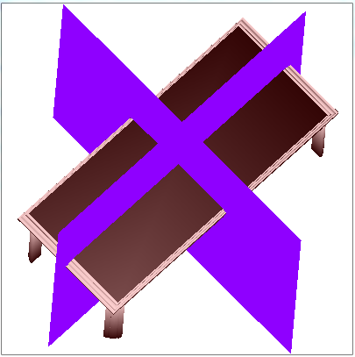
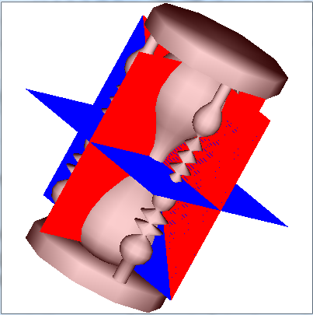
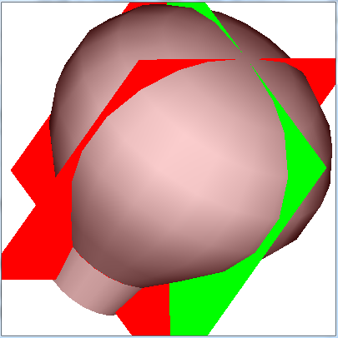
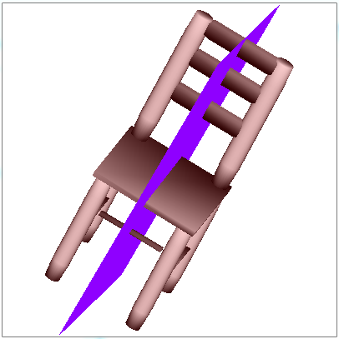
3D Reflection Symmetry
Among different types of symmetry, reflection symmetry is the most important and commonly studied
3D reflection symmetry [Chaouch and Verroust-Blondet 2009]:
Cyclic symmetry: several mirror planes passing through a fixed axis
Dihedral symmetry: several mirror planes passing through a fixed axis with one perpendicular to the axis
Rotational symmetry: look similar after rotation, e.g., different platonic solids, like tetrahedron, octahedron, icosahedron and dodecahedron
Unique symmetry: only one mirror plane, for instance, many natural and most man-made objects
Cyclic
Dihedral
Rotational
Unique
Notes:
First, we introduce 3D reflection symmetry.
<For this slide, simply following the text is fine.>

Slide 3
Motivation
Existing algorithms still have room for improvement w.r.t
Simplicity, Efficiency, Degree of freedom
Most existing symmetry detection methods are geometry-based
Computational efficiency is greatly influenced by the number of vertices of a model
We propose a novel and efficient view-based detection algorithm
Our target is to detect 3D reflection symmetry on the surface of 3D models (we do not consider the internal parts of the models)
Motivated by the symmetric patterns of the viewpoint entropy distribution of symmetric models
Find symmetry plane(s) by matching the viewpoints of the sample views of a symmetric model based on their entropy values
Pros: more accurate (symmetry planes’ positions), efficient (speed), and robust (number of vertices and parameter settings)
Notes:
Next is about the motivation of the algorithm.
Firstly, existing algorithms still have room for improvement in terms of Simplicity and Efficiency in detecting symmetry planes, as well as Degree of freedom to find approximate symmetry planes.
Secondly, most existing symmetry detection methods are geometry-based. Therefore, its
Computational efficiency is greatly influenced by the number of vertices of a model
Considering these, we propose a novel and efficient view-based detection algorithm
Our target is to detect 3D reflection symmetry on the surface of 3D models (we do not consider the internal parts of the models)
It was Motivated by the symmetric patterns of the viewpoint entropy distribution of symmetric models
We Find symmetry plane(s) by matching the viewpoints of the sample views of a symmetric model based on their entropy values
It has following Pros: it is more accurate in terms of both the positions of detected symmetry planes and sensitivity to minor symmetry differences; it is more efficient, and robust to the number of vertices and parameter settings such as view sampling

Slide 4
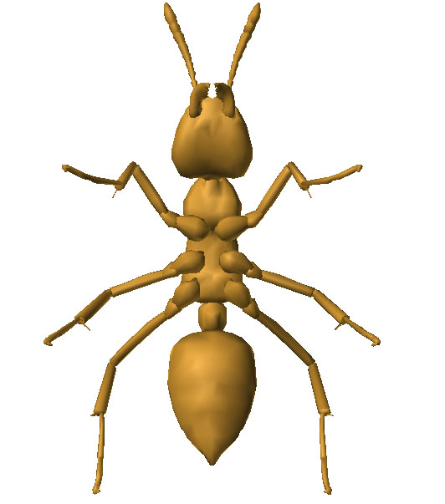
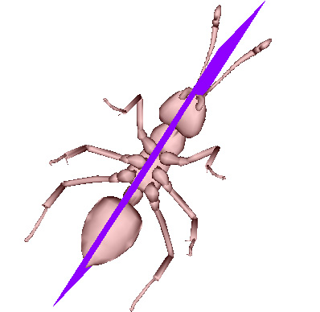
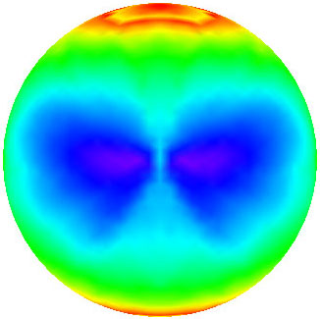
Our View-Based Symmetry Detection
ant model
viewpoint entropy distribution
detected symmetry plane
Symmetry in viewpoint entropy distribution corresponds to the symmetry of the 3D model
Notes:
An overview of our view-based symmetry detection algorithm is shown here.
Left is an example of an ant model, Middle is its viewpoint entropy distribution. It is clear that the Symmetry in viewpoint entropy distribution corresponds to the symmetry of the 3D model.
Based on this, the detected symmetry plane by matching the viewpoints is shown in the right.

Slide 5
Our Symmetry Detection Algorithm
Step 1. 3D model normalization based on CPCA [Vranik 2004]
Purpose: to reduce the search space for symmetry planes
Benefit: symmetry planes will pass the origin
CPCA: better efficiency, accuracy, and robustness
Step 2. Viewpoint sampling and entropy distribution generation
Sample candidate symmetric viewpoints
Compute viewpoint entropy values
Step 3. Symmetry detection based on iterative feature pairing
Viewpoint matching
Accumulate symmetry evidences
Symmetry validation
Notes:
The overall three steps of our symmetry detection algorithms is first shown here.
First, we align the model with Continuous PCA, that is CPCA method. It can reduce the search space for candidate symmetry planes since after alignment, all the symmetry planes will pass the origin. We choose CPCA mainly due to its better efficiency, accuracy, and robustness.
In Step 2, we perform view sampling and compute the viewpoint entropy for each viewpoint.
Finally, we detect the symmetry planes based on iterative feature pairing: first select two matched viewpoints, then based on these two viewpoints compute a candidate symmetry plane (that is viewpoint matching), next we verify other symmetric viewpoints w.r.t the plane to see whether they are matched (accumulate symmetry evidences). Based on the voting results, we validate the symmetry planes (that is, the final step of symmetry validation).
<if time is not enough, can ignore the detailed explanation for Step 3 since later we will explain Step 3>

Slide 6
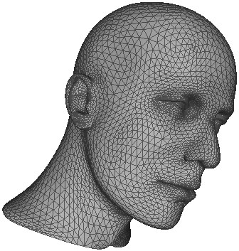
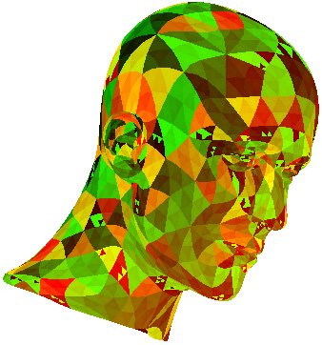
Step 2: Viewpoint Entropy Computation
Viewpoint entropy: an information theory-related measurement, proposed by [Vázquez et al. 2001], to depict the amount of information a view contains
Formulation
Based on Shannon entropy
Incorporate the projection area of each visible face and the number of visible faces
Orthogonal projection-based definition: [Takahashi et al. 2005]
A_{j} : the visible projection area of the j-th (j=1, 2, · · · , m) face of a 3D model
A₀: the background area
S : the total area of the window where the model is rendered:
Notes:
Now, more details about Step 2.
Viewpoint entropy is an information theory-related measurement. It is to depict the amount of information a view contains.
It is formulated based on Shannon entropy and incorporate both the projection area of each visible face and the number of visible faces.
We adopt the orthogonal projection-based definition defined in Takahashi et al. 2005, as shown below.
Here, Aj is the visible projection area of the j-th face of a 3D model while A0 is the background area.
S is the total area of the window. Projection area is computed by counting the total number of pixels inside a projected face.

Slide 7
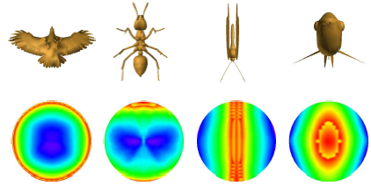
Step 2: View Sampling and Entropy Distr.
Viewpoint sampling: Loop subdivision on a regular icosahedron L₀
Subdivide L₀ n times and denote the resulting mesh as L_{n}
Set the cameras on L_{n}, looking at the origin and use orthogonal projection
blue: large entropy
green: mid-size entropy
red: small entropy
Viewpoint entropy distribution examples
1st row —models after alignment with CPCA
2nd row—respective viewpoint entropy distribution
Notes:
Next, we based on loop subdivision on an icosahedron L_0 n times, we sample a set of views and compute their entropy values and generate its distribution. Some examples are shown below. Blue is large entropy, green is mid-size entropy and red is small entropy. They further verified that the Symmetry in viewpoint entropy distribution corresponds to the symmetry of the 3D model.

Slide 8
Our Symmetry Detection Idea
Relationship between a 3D model and its viewpoint entropy distribution sphere
Perfectly the same symmetry plane
Idea: Symmetry detection of a 3D model ⬄ Finding the symmetry plane of its entropy distribution sphere based on a set of viewpoints
Avoid high computational cost of direct matching among its geometrical properties
Attributes of our view-based symmetry detection algorithm
Highly sensitive to small differences in the model, since
Viewpoint entropy is computed based on the projection of each face of a model
Significantly reduce the computational cost, since
Each viewpoint simultaneously captures the properties of many vertices and faces
Notes:
Therefore, the symmetry of a 3D model can be decided by finding the symmetry in the entropy distribution, thus avoiding the high computational cost of direct matching among its geometrical properties.
What’s more, since viewpoint entropy is computed based on the projection of each face, it is highly sensitive to small differences in the model.
In addition, each viewpoint simultaneously captures the properties of many vertices and faces of a model as a whole, which also helps to significantly reduce the computational cost.

Slide 9
Step 3: Iterative Feature Pairing
Efficient matching based on iterative feature pairing:
Iteratively select a matching pair of viewpoints to generate a symmetry plane
Verify all the rest matching pairs to see whether they are symmetric as well w.r.t the symmetry plane or at least in the symmetry plane
Notes to the algorithm:
Views corresponding to the viewpoints that are located on the symmetry plane do not need to match each other; there are at most 2^{n+2} such vertices
Formulated by induction and verified by program
Numerical problems prevent perfectly matching among view pairs
Relax condition: if the total number (matches) of matched viewpoints w.r.t a candidate symmetry plane is at least N − 2^{n+2}, then it is confirmed as a symmetry plane
δ: a threshold controlling the strictness of symmetry definition
Smaller: strict symmetry / Larger: rough symmetry
Notes:
The last step is to efficiently detect the symmetry plane of the viewpoint entropy distribution based on an iterative feature pairing method. The basic idea is
Iteratively select a matching pair of viewpoints to generate a symmetry plane and then
Verify all the rest matching pairs to see whether they are symmetric as well w.r.t the symmetry plane or at least in the symmetry plane
We have several notes to algorithms:
First, views corresponding to the viewpoints that are located on the symmetry plane do not need to match each other; there are at most 2^{n+2} such vertices which has been verified based on program
Second, numerical problems such as aliasing prevents perfectly matching among view pairs
Therefore, we add a relax condition: if the total number (matches) of matched viewpoints w.r.t a candidate symmetry plane is at least N − 2^{n+2}, then it is confirmed as a symmetry plane

Slide 10
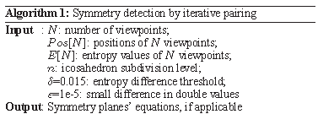
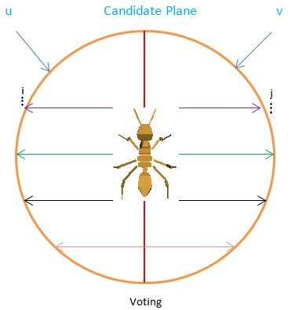
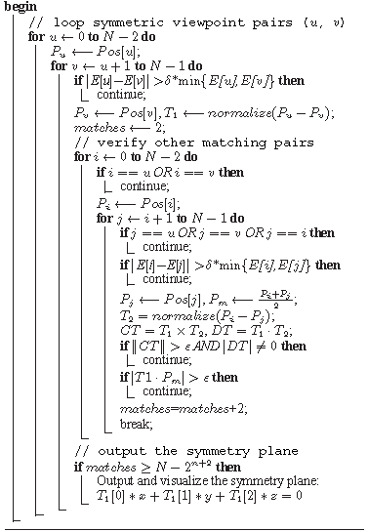
Step 3: Iterative Feature Pairing
Notes:
The visual explanation and the code are illustrated here.
We detect the symmetry planes based on iterative feature pairing: first select two matched viewpoints, then based on these two viewpoints compute a candidate symmetry plane, next we verify other symmetric viewpoints w.r.t the plan to see whether they are matched. Based on the voting scheme, we detect the symmetry planes.

Slide 11
Experiments and Discussions
Evaluation w.r.t dataset-level performance
Time efficiency
Accuracy of symmetry planes
Symmetry planes detection rate
Notes:
We perform experiments w.r.t efficiency, accuracy and dataset-level detection rate.
<Since time is limited, we skip the robustness experiments part and let audience refer to the paper for details.>

Slide 12
Time Efficiency
Compare ours with two state-of-the-art approaches
Mean shift [Mitra et al. 2006]
3D Hough [Cailliere et al. 2008]
Focus: change of the running time w.r.t the increase in #vertices
Finding: ours has better efficiency in terms of scalability to #vertices
Timing information (in seconds) comparison of our methods and other two state-of-the-art approaches
Notes:
We Compare ours with two state-of-the-art approaches
Mean shift [Mitra et al. 2006]
3D Hough [Cailliere et al. 2008]
We focus on the change of the running time w.r.t the increase in #vertices (see the tendency of the time increase in each row)
We find that ours has better efficiency in terms of scalability to #vertices
This is mainly because the computational time of our view-based approach does not increase linearly with the increase in the number of vertices since we
just render the 3D model first and detect its symmetry only based on the rendered views.

Slide 13
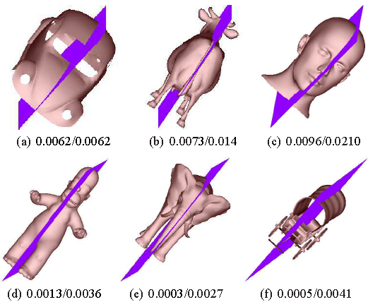
Symmetry Detection Accuracy
Symmetry detection results with mean/max error measures
Better accuracy than Mean Shift and 3D Hough
Symmetry detection results with mean/max error
Notes:
Next we compare the accuracy of the detected symmetry planes.
To measure the accuracy of the detected symmetry planes, we adopt the mean and maximum distance errors developed in Metro. It also shows better accuracy than Mean Shift and 3D Hough.

Slide 14
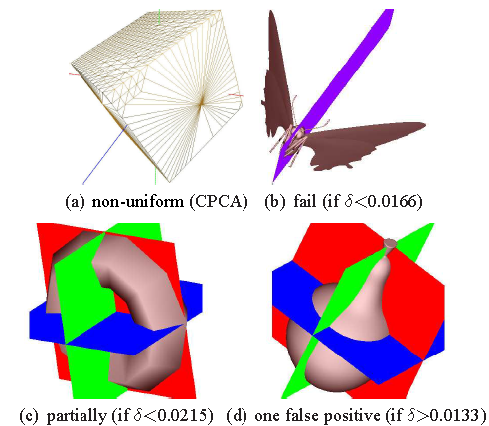
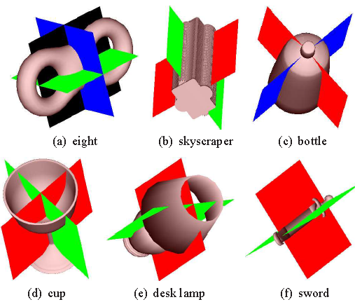
Multiple Symmetry Planes
Can detect multiple symmetry planes
E.g. Eight, Skyscraper, Bottle, Cup, Desk Lamp, and Sword
Some unsuccessful cases
Failed or partially failed examples
Example of multiple symmetry planes
Notes:
We also find that our approach can simultaneously detect multiple symmetry planes for certain types of meshes, such as the Eight, Skyscraper, Bottle,
Cup, Desk Lamp, and Sword models. <show in the left>
While, due to the limitation of CPCA and the sensitivity property to minor changes of the viewpoint entropy feature, there are a few fail cases or certain
cases where the proposed method can only partially determine a set of reflection planes. Some examples are shown in right.
For example, because of non-uniform triangulation, the cube model cannot be perfectly aligned with CPCA, resulting in the unsuccessful symmetry
plane detection.

Slide 15
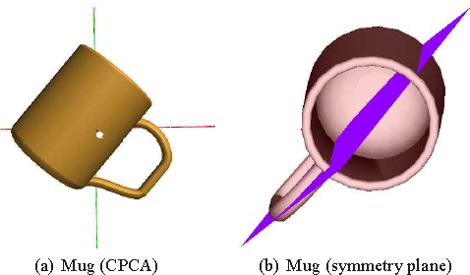
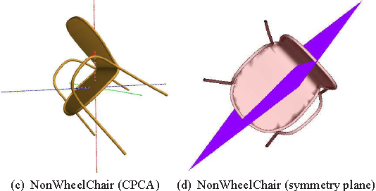
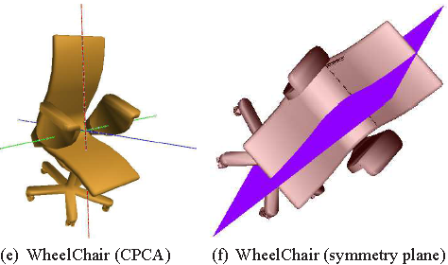
Symmetry Detection w.r.t CPCA Accuracy
Test CPCA alignment accuracy on symmetry detection
Successfully detect the symmetry planes even if the models cannot be perfectly aligned with CPCA
Detection rates for models that cannot be accurately aligned by CPCA: Mug: 7/8, NonWheelChair: 18/19, WheelChair: 6/7
Notes:
However, we found that our algorithm can successfully detect the symmetry planes of most models that are not perfectly aligned with CPCA.
For example, the detection rates for: Mug is 7 by 8, NonWheelChair: 18 by 19, WheelChair: 6 by 7

Slide 16
Symmetry Planes Detection Rate
Dataset-level symmetry detection performance
True Positive (TP): detect a symmetry plane of a symmetric model
False Positive (FP): detect a symmetry plane of an asymmetric model
True Negative (TN): do not detect any symmetry plane of an asymmetric model
False Negative (FN): fail to detect a symmetry plane of a symmetric model
Overall symmetry detection performance of our algorithm based on the first 200 models of the NIST benchmark
Detection Rate (DR, $\frac{TP}{TP+FN}$) = 82.3%
Accuracy (AC, $\frac{TP+TN}{TP+TN+FP+FN}$) = 75.6%
Notes:
Finally, we evaluate the overall performance on a dataset level.
We test on the first 200 models of the NIST benchmark and examine each detected symmetry plane to see whether it is a
True Positive (TP):that is, detected a symmetry plane of a symmetric model
or False Positive (FP):, that is, detect a symmetry plane of an asymmetric model
Or for a undetected symmetry plane to see whether is a True Negative (TN), or False Negative (FN).
The final results are in the table. We achieved a more than 80% detection rate and about 75% accuracy, which are good enough.
<though no dataset-level results can be found to perform a comparison>

Slide 17
Conclusions and Future Work
Conclusions
Symmetry in viewpoint entropy distribution corresponds to the symmetry of the 3D model
Propose an efficient and novel view-based symmetry detection method
Demonstrate a good performance in accuracy and efficiency
Validate good robustness, detection rate, and flexibility on a dataset level
Future work
3D model alignment
Best view selection
Notes:
Let’s conclude.
The main idea is that Symmetry in viewpoint entropy distribution corresponds to the symmetry of the 3D model
Thus, we propose an efficient and novel view-based symmetry detection method.
a good performance in accuracy and efficiency has been deomonstrated
Validate good robustness, detection rate, and flexibility on a dataset level
We plan to apply the algorithm into following applications
Combine CPCA with Minimum Projection Area (MPA)
Develop an automatic and adaptive strategy to select an appropriate entropy difference threshold δ for respective models or classes
Apply our symmetry detection algorithm on
3D model alignment
Best view selection

Slide 18
Questions?
Please email B_L58@txstate.edu.
Thank you!

