Slide 1
Sketch-Based 3D Model Retrieval by Viewpoint Entropy-Based Adaptive View Clustering
Bo Li¹, Yijuan Lu¹, Henry Johan²
¹ Texas State University, USA
² Fraunhofer IDM@NTU, Singapore
Notes:
Good afternoon, everyone. The title is Sketch-Based 3D Model Retrieval by Viewpoint Entropy-Based Adaptive View Clustering.
It is a joint work of Bo Li, Yijuan Lu from Texas State University and Henry Johan from Frannhofer IDM@NTU.

Slide 2
Outline
Introduction
Related work
Viewpoint entropy distribution-based view clustering
Our sketch-based retrieval algorithm
Experimental results and discussion
Conclusions and future work
Notes:
It includes six sections. First we start with Introduction part.

Slide 3
Introduction (1/3)
Sketch-based 3D model retrieval (SBR) is to retrieve relevant 3D models using sketch(es) as input
SBR characteristics:
Intuitive and easy for users to search for relevant models
People are more accustomed to “sketching” their ideas using sketches
Useful for related applications:
Sketch-based modeling and recognition
3D animation production via 3D reconstruction of a 2D scene sketch
Existing SBR algorithms compare a 2D sketch with a fixed number of predefined sample views of a 3D model, no matter how complex it is:
Funkhouser et al. [FMK03]: 13 sample views
Kanai [Kan08], Yoon et al. [YSSK10]: 14 sample views
Limitations: did not consider the complexities of different models; no guarantee about the representativeness of sample views
Notes:
Sketch-based 3D model retrieval (SBR) is to retrieve relevant 3D models using sketch(es) as input.
SBR is an intuitive and easy way for users to search for relevant 3D models.
This is mainly because sketches are more human-friendly and people are more accustomed to “sketching” their ideas using a set of sketches.
It is also useful for related applications such as sketch-based 3D modeling and recognition.
Recently, quite a few sketch-based 3D model retrieval algorithms have been proposed.
However, most of the available algorithms compare the 2D sketch query with a fixed number of predefined sample views of each 3D model, no
matter how complex the model is.
For example, Funkhouser et al. [FMK03] compared a sketch with 13 sample views for each model;
Both Kanai [Kan08] and Yoon et al. [YSSK10] adopted the 14 sample views approach.
However, these sampling strategies have some limitations. They do not consider the complexities of different models, thus cannot guarantee that the extracted sample views are representative enough to depict a 3D model.
In fact, there is no need to sample and compare 13 or 14 views for a simple model, such as a sphere or a cube, while more views should be sampled
for a complicated model. Therefore, an adaptive sampling strategy is needed.

Slide 4
Introduction (2/3)
SBR-VC: propose a Sketch-Based 3D Model Retrieval based on adaptive View Clustering by utilizing the viewpoint entropy distribution of a 3D model
View clustering idea: Cluster a set of sample views of a 3D model into an appropriate number of representative views according to its 3D visual complexity
Defined as the viewpoint entropy distribution of a set of uniformly sampled views of the model
Used to decide the number of the representative views of the model
FCM view clustering: Fuzzy C-Means clustering on the sample views based on their viewpoint entropy values and locations
2D-3D matching: shape context matching [BMP02] between a 2D sketch and the representative views of each 3D model
Notes:
The Basic idea is that: 3D models often differ in their visual complexities, thus there is no need to sample the same number of views to represent each model. We sample different number of representative views according to the visual complexity of a 3D model
SBR-VC: we propose a Sketch-Based Retrieval algorithm based on adaptive View Clustering by utilizing viewpoint entropy distribution, named SBR-VC.
Visual complexity metric: It is about viewpoint entropy distribution of a set of sample views of a model. Based on Visual complexity metric the number of the representative views of the 3D model is adaptively assigned.
Then, a Fuzzy C-Means view clustering is performed on the sample views based on their viewpoint entropy values and viewpoint locations.
Finally, shape context matching [BMP02] is utilized during online retrieval for the matching between a query sketch and the representative views for each target model.

Slide 5
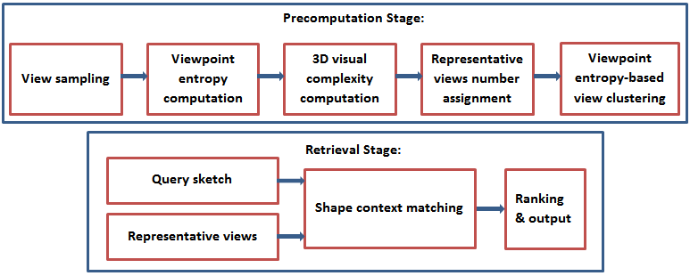
Introduction (3/3)
An overview of the SBR-VC algorithm
Notes:
An overview of the algorithm is shown in the figure. It comprises Two stages: precomputation and online retrieval.
In the course of precompuation stage, for each 3D model, we first uniformly sample a set of view locations, and compute their viewpoint entropies, based on which we compute the visual complexity of the model. Based on the visual complexity value, we assign the number of clusters when performing fuzzy c-means view clustering on the sample views of the model.
During the online retrieval stage, we compare the query sketch with each representative view based on shape context matching and regard the minimum distance as the final 2D-3D distance.

Slide 6
Outline
Introduction
Related work
Viewpoint entropy distribution-based view clustering
Our sketch-based retrieval algorithm
Experimental results and discussion
Conclusions and future work

Slide 7
Related Work
Sketch-based 3D model retrieval: classified according to different view sampling strategies
Using predefined views: matching sketches with the predefined sample views rendered from certain fixed viewpoints
Shao et al. [SXY11]: 7 views: 3 canonical views (front, side, top) and 4 corner views sampled on a cube
Yoon et al. [YSSK10]: 14 suggestive contours feature views: 6 orthographic and 8 isometric views
Eitz et al. [EHBA10]: Sampled 50 views. But no database-level performance; [EHBA11, LSG12]: further sampled 102 views and performed experiments on a database level
Li and Johan [LJ12, LSG12]: 2D sketch-3D model alignment by shortlisting a set of candidate views from 81 sample views
Shortcoming: ignoring the representativeness regarding the selected views which is also the motivation for our algorithm
Notes:
Sketch-Based 3D Model Retrieval: classified according to different view sampling strategies.
Using Predefined Views: matching sketches with the predefined sample views rendered from certain fixed viewpoints.
Yoon et al. [YSSK10] developed a sketch-based retrieval algorithm based on the diffusion tensor fields feature representation and matched a sketch with 14 suggestive contours feature views of a model. Shao et al.
[SXY11] proposed to perform the sketch-based retrieval based on a direct and robust contour-based shape matching method. For each model, they rendered and compared with 7 views which comprise 3 canonical views (front, side, top) and 4 corner views sampled on a cube.
Eitz et al. [EHBA10] adopted a Bag-of-Features (BoF) framework and extracted Histogram of Gradient (HOG) local features for the subdivided patches of both sketch and views. They sampled 50 views and tested on the Princeton Shape Benchmark (PSB) [SMKF04a] using several sketches but did not provide the overall performance.
In [EHBA11, LSG12], they further sampled 102 views and performed experiments on a database level.
Li and Johan [LJ12, LSG12] proposed an algorithm by first approximately aligning a 2D sketch with a 3D model, in terms of shortlisting a set of candidate views
Shortcoming: ignoring the representativeness regarding the selected views which is also the motivation for our algorithm

Slide 8
Sketch-Based 3D Model Retrieval
Using clustered views: matching sketches with the clustered views generated by view clustering. Only a few work was done:
Mokhtarian and Abbasi [MA05]:
View clustering by matching rendered views
Discarding similar views in terms of matching cost
Ansary et al. [AVD07]: image-based 3D model retrieval
Clustering 320 sample views into several characteristic views using Bayesian probabilistic approach
Unfortunately, only one demo result for sketch queries
No overall performance
Notes:
The second strategy is:
Using Clustered Views: matching sketches with the clustered views generated by view clustering. Much less research work has been done for this strategy.
Mokhtarian and Abbasi [MA05]: proposed a view clustering method by matching the rendered views and discarding the similar views whose matching costs fall in a predefined threshold.
Ansary et al. [AVD07]: proposed an image-based 3Dmodel retrieval algorithm by clustering 320 sample views into a set of characteristic views based on the Bayesian probabilistic approach. Unfortunately, only one demo result for sketch queries was given and no overall performance was evaluated.

Slide 9
Shape Complexity
Geometrical shape complexity: Rossignac [Ros05]
Classification: Algebraic, Topological, Morphological, Combinational, Representational
3D visual complexity
Saleem et al. [SBWS11]:
Using feature distance analysis of its sample views
Page et al. [PKS03]:
Defined a 2D/3D shape complexity based on the entropy of curvatures
Rigau et al. [RFS05]:
Inner and outer shape complexities based on mutual information
Viewpoint entropy: Vázquez et al. [VFSH03]
Information theory related measurement
Amount of information a view contains
Notes:
Geometrical shape complexity approaches have been reviewed by Rossignac [Ros05] from five perspectives: algebraic,
topological, morphological, combinational, and representational.
Recently, a new tendency is to measure the visual complexity of a 3D model. For example,
Saleem et al. [SBWS11] measured the visual complexity of a 3D model based on the feature distance analysis of its sample views;
Page et al. [PKS03] defined a 2D/3D shape complexity based on the entropy of curvatures;
Rigau et al. [RFS05] measured the inner and outer shape complexities based on mutual information.
Utilizing information theory related measurement to characterize the visual information features of a sample view of a 3D model has been recognized as an effective way, thus useful for 3D shape complexity measurement as well.
Vázquez et al. [VFSH03] proposed viewpoint entropy to depict the amount of information a view contains and based on this, they developed a method to automatically find a set of best views with top view entropy values.

Slide 10
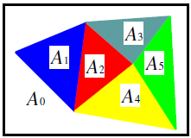
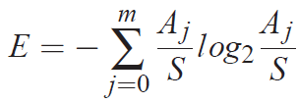
Viewpoint Entropy Definition
Viewpoint entropy: Vázquez et al. [VFSH03]
For a 3D model with m faces, the viewpoint entropy E of a view is defined as follows:
A_{j} is the visible projection area of the j^{th} ( j=1,2,···,m) face of a model
A₀ is the background area
S is the total area of the window where the model is rendered:
Assignment of different colors to visible faces on the 2D screen [TFTN05]
Notes:
The definition and computation of Viewpoint Entropy is as follows.
For a 3D model with m faces, the viewpoint entropy of a view is defined as follows,
E=…
where, A_{j} is the visible projection area of the j^{th} ( j=1, 2, · · ·,m) face of a 3D model and A₀ is the background area. See the figure.
S is the total area of the window where the model is rendered, that is S=…

Slide 11
Outline
Introduction
Related work
Viewpoint entropy distribution-based view clustering
Our sketch-based retrieval algorithm
Experimental results and discussion
Conclusions and future work

Slide 12
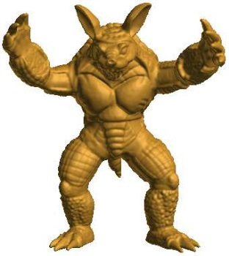
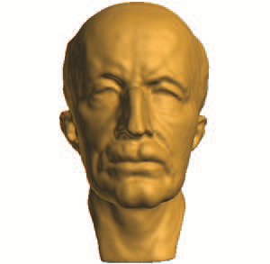
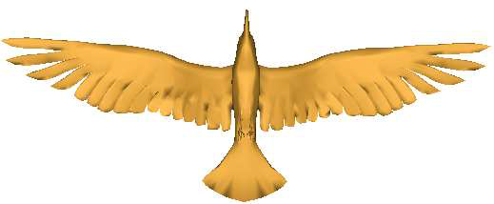
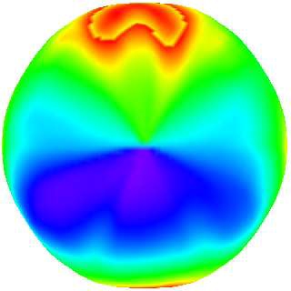
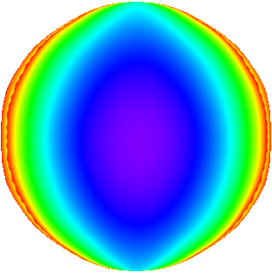
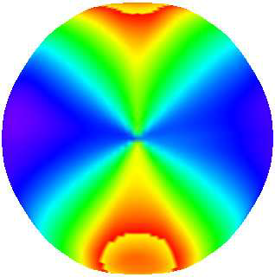
Viewpoint Entropy-Based Adaptive View Clustering
Step 1. Viewpoint entropy distribution
Subdivide a regular icosahedron (denoted as L0) n times based on the Loop subdivision algorithm and name the resulting shape as Ln
For each model, sample a set of viewpoints by setting the cameras on the vertices of Ln and then compute their viewpoint entropy values
Viewpoint entropy distribution examples. Using HSV color model and smooth shading. Red: small entropy; green: mid-size entropy; blue: large entropy.
Notes:
We propose a 3D visual complexity metric based on the viewpoint entropy distribution of a set of sample views of a 3D model.
After that, we apply the 3D visual complexity metric into our sketch-based 3D model retrieval algorithm to decide the number of representative
views (cluster centers) to represent a 3D model.
Step 1. Viewpoint entropy distribution
We subdivide a regular icosahedron (denoted as L0) n times based on the Loop subdivision algorithm and name the resulting shape as Ln
For each model, sample a set of viewpoints by setting the cameras on the vertices of Ln and then compute their viewpoint entropy values
Figure: Viewpoint entropy distribution examples:
First row shows the models (in the original poses);
Second row demonstrates the viewpoint entropy distributions of the models seen from the original poses.
Viewpoint entropy is coded using HSV color model and smooth shading. Red: small entropy; green: mid-size entropy; blue: large entropy.
It can be seen that for a 3D model, the complexity of its entropy distribution pattern is highly related to the complexity of its geometry.
For instance, the two complex models Armadillo and Maxplanck have a more complicated pattern than the relatively simpler model bird.

Slide 13
Viewpoint Entropy-Based Adaptive View Clustering
Step 2. Viewpoint entropy-based 3D visual complexity
The visual complexity metric is defined based on a class-level entropy distribution analysis on a 3D dataset
3D visual complexity C is defined as follows:
where, and are the normalized standard deviation entropy value s and mean value m by their respective maximums over all the classes
Characteristic of the metric: capable of reasonably reflecting the semantic distances among different model classes. Example (Figs. (a),(b))
Step 3. Viewpoint entropy-based FCM adaptive views clustering
Set the number of representative views N_{c} to be proportional to its visual complexity C:
is the total number of sample views in the algorithm, we set .
Example Fig. (c)
Notes:
Step 2. Viewpoint Entropy-Based 3D Visual Complexity.
The visual complexity metric is defined based on a class-level entropy distribution analysis on a 3D dataset.
Mean and standard deviation entropy values m and s among all the sample views of a 3D model are first computed, followed by an average over all the models for each class. 3D visual complexity C is defined as follows,
where, s_bar and m_bar are the normalized s and m by their respective maximums over all the classes.
The metric is capable of reasonably reflecting the semantic distances among different classes of models.
Step 3. Viewpoint Entropy-Based FCM Adaptive Views Clustering.
We set the number of representative views N_{c} to be proportional to its visual complexity C.
N_{c} = a·C·N₀
where, N0 is the total number of sample views in the sample view space and a is a constant.
Since we only consider half of the view space, correspondingly we set a = 1.
The corresponding numbers of representative views N_{c} for the 13 classes are listed in Figure (c). See.

Slide 14
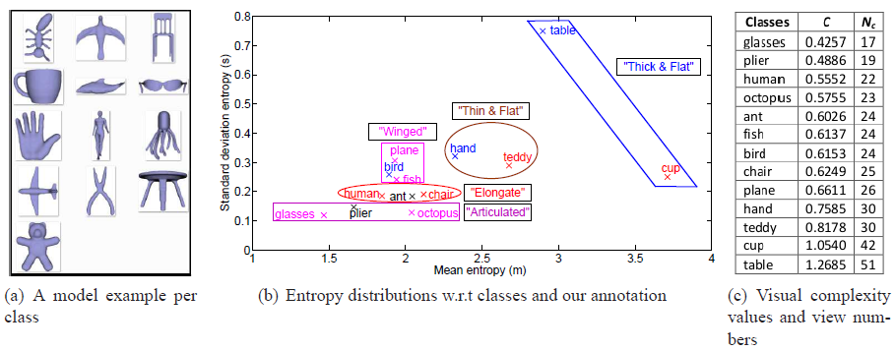
Viewpoint Entropy-Based Adaptive View Clustering
Viewpoint entropy distributions and numbers of representative views of different classes in the partial WMB 3D benchmark: 13 selected classes, 260 models, 20 each.
Figure (c) sorts and lists the 3D visual complexity values of the 13 classes
Back
Notes:
As an example, we select the Watertight 3D Model Benchmark (WMB).
It comprises 13 selected classes, 260 models, 20 each. One sample from each class is shown in Figure (a).
Figure (b) shows the entropy distributions of different classes and the analysis of our clustering results.
As shown in the figure, viewpoint entropy reasonably reflects the semantic distances among different classes.
For example, “bird”, “plane” and “fish” all have “wings” and are also visually similar.
“Human”, “ant” and “chair” share the characteristic of elongate shapes.
“Hand” and “teddy”, “cup” and “table” have the following same properties: the areas of certain (usually the front,
top and side) views are apparently larger than other views; most views of these classes have bigger projection areas than
those of other classes, thus both their mean and standard deviation entropy values are larger.
Both types are flat but have differences in thickness and thus we denote these classes as “thin & flat” and “thick & flat” types, respectively.
Figure (c) sorts and lists the 3D visual complexity values of the 13 classes.

Slide 15
Outline
Introduction
Related work
Viewpoint entropy distribution-based view clustering
Our sketch-based retrieval algorithm
Experimental results and discussion
Conclusions and future work

Slide 16
Online Retrieval Algorithm
Step 1. Sketch feature extraction
Extract outline feature view for a 2D sketch
Compute its relative shape context features
Step 2. Sketch-model distance vector computation
Shape context matching between sketch and each representative view
Regard the minimum matching cost as the sketch-model distance
Step 3. Sketch-model distances sorting and output
Sort all the sketch-model distances in an ascending order
List the corresponding models accordingly
Notes:
Given a query sketch and a 3D database, based on the representative views and their precomputed
relative shape context features for each model, we develop the following online retrieval algorithm.
(1) Sketch feature extraction. We extract the outline feature view for the 2D sketch and compute its relative shape
context features.
(2) Sketch-model distance vector computation. For each model, we perform shape context matching between the
sketch and each representative view and regard the minimum matching cost as the sketch-model distance.
(3) Sketch-model distances sorting and output. We sort all the sketch-model distances in an ascending order and list the
corresponding models accordingly.

Slide 17
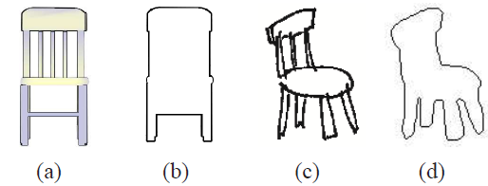
Feature Views Generation
Outline feature view
To compute distance between a 3D model and a query sketch
Considerations: robustness, effectiveness and efficiency
For 3D models, render silhouette views, then extract outlines
For query 2D sketch, generate silhouette view: binarization, Canny edge detection, closing, dilation, and region filling
2D/3D feature views generation examples. (a) curvature view of a chair model in PSB [SMKF04a]; (b) outline view; (c) a hand-drawn chair sketch in Yoon et al.’s [YSSK10] sketch benchmark; (d) outline view of the chair sketch
Notes:
Feature views generation: outline feature view
Considering robustness, effectiveness, and efficiency, we extract outline feature views for both 2D sketches and 3D models in our algorithm.
For 3D, first render silhouette views and then extract the outlines.
For 2D, we also first generate its silhouette view mainly through a series of morphological operations: binarization, Canny edge detection, morphological closing, dilation to fill the gaps between sketch curves, and region filling.
One example showing the 2D and 3D outline feature views is as follows.

Slide 18
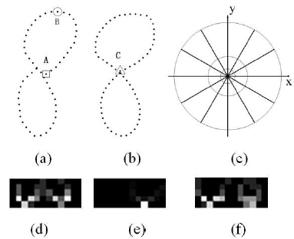
Feature Extraction
Shape context: used to compute the distance between two outline feature views (one for sketch and one for model)
A log-polar histogram that defines the relative distribution of other points with respect to a point
Shape context examples. (d), (e), (f) are the shape context features of points A and B in (a) and point C in (b) respectively. Darker means a smaller value
Notes:
Shape context is utilized to compute the distance between two outline feature
views (one for sketch and one for model) during the retrieval stage.
Shape context is a log-polar histogram and defines the relative distribution of other points with respect to a point.
The default shape context definition partitions the surrounding area of a sample point of a 2D shape into 5 distance
bins and 12 orientation bins, as shown in Figure (c).Thus, the shape context is represented by a 5 × 12 matrix.
Shape context examples. In this Figure, we show the shape context features of three points in two shapes. (d), (e), (f) are the shape context features of points A and B in (a) and point C in (b) respectively. The grayscale value of each element represents the percentage of other points in each bin. Darker means smaller.
As shown in Figure (d) and (e), different points have different shape context features in one shape and similar points in two similar shapes usually have similar shape context features, like Figure (d) and Figure (f).
Shape context is scale and transformation-invariant but not rotation-invariant. To achieve the property of rotation invariance, in [BMP02] a relative frame is defined by adopting the local tangent vector at each point as the reference x axis for angle computation and we name it relative shape context. To encompass the differences in the camera up-vectors during the process of outline feature views generation, we extract the rotation-invariant relative shape context features for each feature view, as presented in next slide.

Slide 19
Relative Shape Context Feature Matching
Step 1. Uniformly sample 100 feature points for an outline feature view
Using cubic B-Spline interpolation and uniform sampling
Step 2. Extract relative shape context for each point
Step 3. Use LAP [JV87] method to match two outline views
The minimum matching cost is regarded as the 2D-3D distance
Notes:
First, we uniformly sample 100 feature points for an outline in the feature view based on cubic B-Spline interpolation
and uniform sampling.
Then, we extract the relative shape context feature [BMP02] for each point.
Finally, Jonker’s Linear Assignment Problem (LAP) algorithm [JV87] is used to match the feature
points of two outline feature views and the minimum matching cost is their distance.

Slide 20
Outline
Introduction
Related work
Viewpoint entropy distribution-based view clustering
Our sketch-based retrieval algorithm
Experimental results and discussion
Conclusions and future work

Slide 21
Experimental Results and Discussion
Two benchmarks
Yoon Et Al.’s Benchmark [YSSK10,LSG12]
13 classes: 250 sketches, 260 models
SHREC’13 Sketch Track Benchmark [LLG13]
90 classes: 7200 sketches (80 per class), 1258 models
Performance metrics [SMKF04a]
Precision-Recall (PR) diagram
Nearest Neighbor (NN), First Tier (FT), Second Tier (ST), E-Measure (E), Discounted Cumulative Gain (DCG)
Example 2D sketch per class in Yoon Et Al.’s Benchmark.
Example 2D sketches and relevant 3D models in the SHREC’13 Sketch Track Benchmark
Notes:
In this section, we test our approach on two latest sketch-based 3D model retrieval benchmark datasets:
Yoon et al.’s Benchmark [YSSK10,LSG12] and SHREC’13 Sketch Track Benchmark [LLG13].
Yoon Et Al.’s Benchmark [YSSK10,LSG12]
It comprises 13 classes: 250 sketches, 260 models. One example 2D sketch per class is shown in this figure. For 3D model example per class, we have show it in Fig. (a) of the previous slide (Slide 14).
SHREC’13 Sketch Track Benchmark [LLG13]
To evaluate and solicit latest and state-of-the-art sketch-based retrieval algorithms on a large-scale benchmark, Li et al. [LLG13] built a new benchmark for the Shape Retrieval Contest (SHREC) 2013 Track on Large Scale Sketch-Based Retrieval.
It contains 90 classes: 7200 sketches (80 per class), 1258 models.
To comprehensively evaluate the retrieval performance, we select six performance metrics:
Precision-Recall (PR) diagram
Nearest Neighbor (NN), First Tier (FT), Second Tier (ST), E-Measure (E), Discounted Cumulative Gain (DCG)

Slide 22
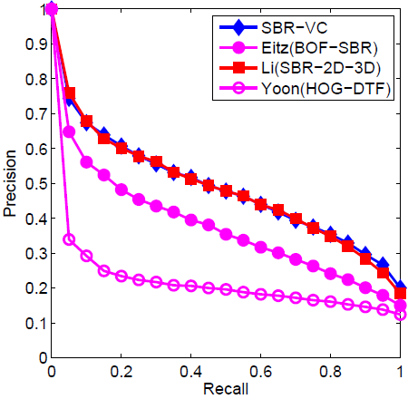
Yoon Et Al.’s Benchmark
Overall performance
Apparently better than HOG-DTF and BOF-SBR
Similar performance as SBR-2D-3D: the top search algorithm in the SHREC’12 Sketch Track [LSG12]
Simpler and much (at least 20 times) faster view selection process
Other performance metrics comparison
Precision-Recall diagram performance comparison
Notes:
Overall performance as shown in the figure and table
Our retrieval performance is apparently better than HOG-DTF and BOF-SBR
It also achieves similar performance as SBR-2D-3D: the top search algorithm in the SHREC’12 Sketch Track [LSG12]
Our view selection approach is simpler and at least 20 times faster than that of SBR-2D-3D
Explain:
Our viewpoint entropy-based approach can achieve the same search accuracy without performing a 2D sketch-3D
model alignment. Therefore, our view selection approach is effective, but simpler, efficient,
and much faster in computation (at least m-1 times faster than the 2D-3D alignment method of SBR-2D-3D, where
m is the number of base views and is set as 21 in Eq. 9 of [LJ12]).
Therefore SBR-VC has superior scalability than SBR-2D-3D, thus it can be easily scaled to a large scale sketch-based 3D model retrieval application.

Slide 23
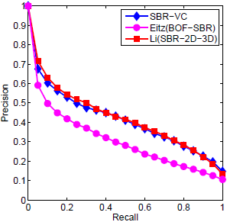
Extended Yoon Et Al.’s Benchmark
Scalability robustness performance
Extended Yoon Et Al.’s Benchmark: add the rest 140 models
Comparable robustness as SBR-2D-3D:
FT and DCG performance decreases: SBR-VC: 12.9% and 6.6%; BOF-SBR: 18.0% and 7.3%; SBR-2D-3D: 10.6% and 5.3%
Superior scalability than SBR-2D-3D: less computation, memory cost
Other performance metrics comparison
Precision-Recall diagram performance comparison
Notes:
Scalability robustness performance
To evaluate the scalability property of our algorithm, we perform the same experiment on the Extended Yoon Et Al.’s Benchmark which adds the remained 140 models (7 classes, each with 20 models) of the WMB database. These irrelevant models are regarded as noise to increase the challenge of retrieval. The below figure and table compare their performance again.
We can see that our algorithm also shows a comparable robustness as SBR-2D-3D: The FT and DCG performance decreases are: SBR-VC: 12.9% and 6.6%; BOF-SBR: 18.0% and 7.3%; SBR-2D-3D: 10.6% and 5.3%.
However, it has superior scalability than SBR-2D-3D due to less computation and memory cost:
Unlike SBR-2D-SD, which need compute, save, or load the relative shape context features of all the sample views of the models in the target dataset, SBR-VC has less computation and memory cost. It only need calculate the shape context features of the selected candidate views for each model.
Therefore SBR-VC has superior scalability than SBR-2D-3D, thus it can be easily scaled to a large scale sketch-based 3D model retrieval application.

Slide 24
SHREC’13 Sketch Track Benchmark (1/2)
Large scale benchmark: test and train dataset
Compare SBR-VC with the approaches in the SHREC’13 Sketch Track
SBR-VC achieves much better accuracy than FDC and EFSD
SBR-VC vs SBR-2D-3D: superior performance with comparable efficiency
NN, FT, ST, E and DCG performance increases: 21.1%, 22.8%, 19.2%, 14.9% and 6.1%
(a) Training dataset
(b) Testing dataset
(c) Complete dataset
Precision-Recall diagram performance comparison
Notes:
Notes: Since these two slides are about the results of SHREC'13, we can show them, but we don't need to present them in details in this session because there will be a separate presentation for SHREC results. Following is the detailed description, but you may ignore some parts.
SHREC’13 Sketch Track Benchmark is for large scale retrieval. It is also divided into test and train datasets. We compare SBR-VC with the approaches in the SHRSC’13 Sketch Track.
The comparison results on the “Training”, “Testing”, and “Complete” benchmark datasets are shown in below figure and table (next slide).
For SBR-VC, we tested different number of sampling points, denoted by NUM, such as 50 or 100.
To accustom to the large-scale retrieval for efficiency consideration, we keep less representative views by setting alpha = 1/6 . We add the parameter settings into the algorithm name, such that SBR-VC-NUM-50 means the NUM is set to 50, and so on so forth.
It can be observed that:
SBR-VC achieves much better accuracy than FDC and EFSD
SBR-VC_NUM_100 has comparable efficiency as SBR-2D-3D_NUM_0, while it achieves superior performance, e.g., the NN, FT, ST, E and DCG performance increases are: 21.1%, 22.8%, 19.2%, 14.9% and 6.1%

Slide 25
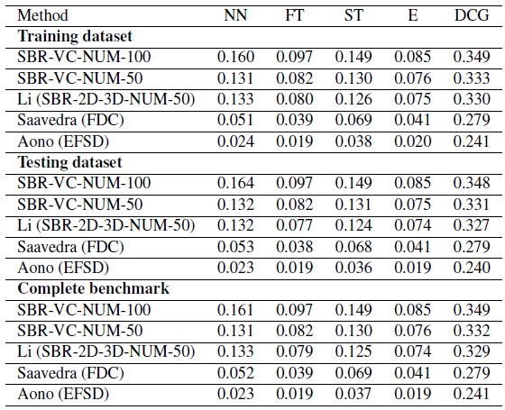
SHREC’13 Sketch Track Benchmark (2/2)
All the retrieval performance values are not high
Challenging benchmark
Many variations in sketches
Many target classes only contain few models
Accurately retrieving these classes of models is difficult
SBR-VC still achieved superior performance though the benchmark is challenging
Demonstrate SBR-VC’s better robustness compared to SBR-2D-3D, FDC, and EFSD
Other performance metrics comparison
Notes:
It is noticed that all the retrieval performance values are not high. This is mainly because of the
Challenging benchmark
A lot of variations exist in the sketches
Many target classes only contain few models
Accurately retrieving those classes of models is difficult and the performance evaluation values on these classes are usually much lower, especially on NN, FT, and ST values.
Even though, SBR-VC still shows its superior performance compared to other state-of-the-art approaches, such as SBR-2D-3D, FDC, and EFSD. This also demonstrates the robustness of our approach.

Slide 26
Outline
Introduction
Related work
Viewpoint entropy distribution-based view clustering
Our sketch-based retrieval algorithm
Experimental results and discussion
Conclusions and future work

Slide 27
Conclusions and Future Work (1/2)
Conclusions: a sketch-based 3D model retrieval algorithm
First clustering the sampled views of a model into adaptively specified number of representative feature views guided by the viewpoint entropy-based visual complexity metric
Then shape context matching the sketch and each representative view
Our contributions:
Quantitatively study and formulate the 3D visual complexity problem
Propose a reasonable and effective 3D visual complexity metric based on viewpoint entropy distribution
Demonstrate promising application potential in sketch-based 3D model retrieval
Successfully apply the 3D visual complexity metric to adaptively decide the number of representative views for each 3D model
Comparative experiments demonstrated our outperforming performance
Provide a path for view clustering-based 3D model retrieval
Useful for the research in visual complexity estimation of a 3D model
Notes:
Conclusion: We have presented a sketch-based 3D model retrieval algorithm by first clustering the sampled views of a 3D model into adaptively specified number of representative feature views and then employing shape context matching to compare the sketch with each representative feature view
Our contributions can be summarized as follows:
Firstly, we quantitatively study and formulate the visual complexity analysis of a 3D model problem. Based on this, we propose a reasonable and effective 3D visual complexity metric by measuring the information theory-related viewpoint entropy.
Secondly, our proposed approach shows promising application potential for sketch-based 3D model retrieval. The 3D visual complexity metric has been successfully applied to adaptively decide the number of representative views for each 3D model. By a set of comparative experiments on two latest sketch-based 3D model retrieval benchmarks, the outperforming performance of our approach have been demonstrated.
Thirdly, our work provide a path for view clustering-based 3D model retrieval. It is will also helpful for the research in visual complexity estimation of a 3D model.

Slide 28
Conclusions and Future Work (2/2)
Experiments on small-scale and large-scale benchmarks have demonstrated the effectiveness of SBR-VC:
Better performance than BOF-SBR, HOG-DTF, FDC, and EFSD
Comparable to SBR-2D-3D w.r.t accuracy and robustness
Viewpoint entropy-based approach is simpler and more efficient
Future work
Assign different number of representative views to the models even within one class based on their complexity values
Apply our 3D visual complexity metric into other related applications
Notes:
Experiments on small-scale and large-scale benchmarks have demonstrated the effectiveness of SBR-VC:
It achieves better performance than BOF-SBR, HOG-DTF, FDC, and EFSD
It is comparable to SBR-2D-3D in terms of both overall performance and scalability robustness
However, the viewpoint entropy-based approach of SBR-VC is simpler and more efficient. Thus, our proposed approach has achieved similar accuracy as the 2D-3D alignment by adaptive view clustering utilizing the viewpoint entropy distribution and 3D visual complexity analysis.
As future work, we plan to
assign different number of representative views to the models even within one class based on their complexity values
We also plan to apply our 3D visual complexity metric into other related applications.

Slide 29
Acknowledgement
This work is supported by the following grants to Dr. Yijuan Lu
Texas State University Research Enhancement Program (REP)
Army Research Office grant W911NF-12-1-0057
NSF CRI 1058724
Notes:
We would like to thank the supporting fundings to Dr. Yijuan Lu, as follows.

Slide 30
Thank you!
Any Questions?
Notes:
That’s all, thanks for your attention.

