Slide 1







SHREC’16 Track: 3D Sketch-Based 3D Shape Retrieval
Bo Li, Yijuan Lu,
Fuqing Duan, Shuilong Dong, Yachun Fan, Lu Qian, Hamid Laga, Haisheng Li,Yuxiang Li, Peng Liu, Maks Ovsjanikov, Hedi Tabia,
Yuxiang Ye, Huanpu Yin, Ziyu Xue
Notes:
Good afternoon, everyone. I will present our organized SHREC track: 3D Sketch-Based 3D Shape Retrieval.
It is a joint work of the following authors from these institutes.
The first two persons are organizers while other 13 are five groups of participants.

Slide 2
Outline
Introduction
Methods
Evaluation

Slide 3
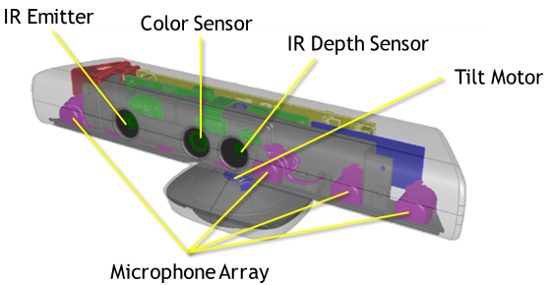
  Motivations
  Motivations:
  2D sketch lacks the 3D shape information of the object it represents
  Semantic gap between 2D sketch and 3D model
  Using 3D sketches for 3D model retrieval
  3D Sketching: an interface allowing users to draw 3D sketches conveniently (i.e., in the air)
  Microsoft Kinect:
    Popular, low cost motion sensor
    Depth sensor
    Multi-array microphone
Notes:
Sketch-based 3D model retrieval is focusing on retrieving relevant 3D models using sketch(es) as input.
Characteristics of the scheme:
Intuitive and convenient, easy for users to learn.
Popular and important for related applications, such as:
Sketch-based modeling and recognition.
3D animation production via 3D reconstruction of a scene of 2D storyboard.
We organized this track to further foster this challenging research area by building an even larger sketch-based 3D retrieval benchmark
Previous work mainly focus on 2D sketch-based 3D object retrieval, while
2D sketch lacks the 3D shape information of the object it represents
Semantic gap between 2D sketch and 3D model
Using 3D sketches for 3D model retrieval
Then, we need to have a 3D sketching interface to allow users to draw 3D sketches conveniently (i.e., in the air)
Microsoft Kinect:
Popular, low cost motion sensor
Depth sensor
Multi-array microphone

Slide 4
  3D Sketch-Based 3D Model Retrieval
  Kinect-based 3D sketching system [1]:
  Use hand to draw a 3D sketch in the air
  Voice-activated Graphical User Interface (GUI)
  Kinect300 3D Sketch Dataset Collection [1]:
  300 sketches, 30 classes, each class has 10 models
  SHREC’13 Sketch Track Benchmark [2]: 1258 models, 90 classes
  Organized this track to foster this challenging research area of 3D sketch-based 3D shape retrieval
[1] Bo Li, Yijuan Lu and et al. 3D Sketch-Based 3D Model Retrieval. ICMR, 555-558, 2015
[2] Bo Li, Yijuan Lu and et al.: SHREC’13 track: Large scale sketch-based 3D shape retrieval. In 3DOR (2013), pp. 89–96.
Notes:
In [1,2], a Kinect-based 3D sketching system was developed to allow a user to use his/her hand
as a drawing tool to draw a 3D sketch. A voice-activated Graphical User Interface (GUI) is designed to facilitate 3D sketching.
Based on the Kinect-based 3D sketching system, we have collected a Kinect300 3D sketch dataset, which
comprises 300 sketches of 30 classes, each with 10 models from 17 users.
We use the target 3D model dataset of the SHREC’13 Sketch Track Benchmark for our target 3D dataset. It contains 1258 models, divided into 90 classes.

Slide 5
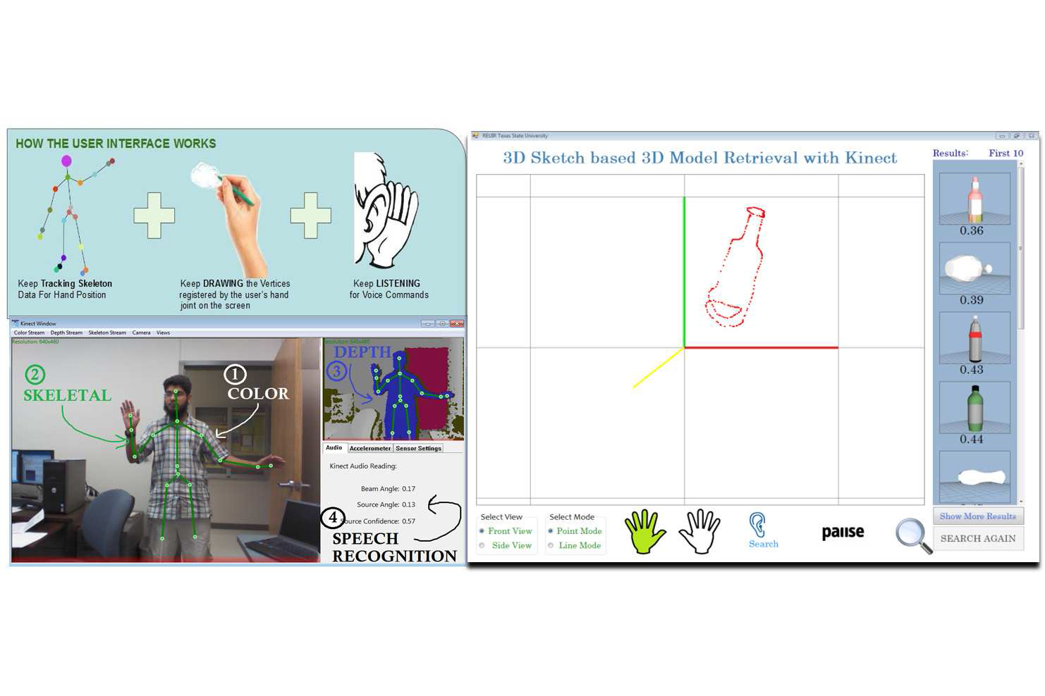
  Kinect-Based 3D Sketching System
Notes:
The Kinect-Based 3D sketching and retrieval interface is demonstrated here:
The system allows users to freely draw 3D sketches in the air as well as to find similar 3D models given human-drawn 3D
sketches.
A user stands in front of a Kinect, which tracks the hand movement of the user to represent a 3D sketch. For convenience, it also allow users to change views when drawing and accept voice commands, such as start, pause and search.

Slide 6
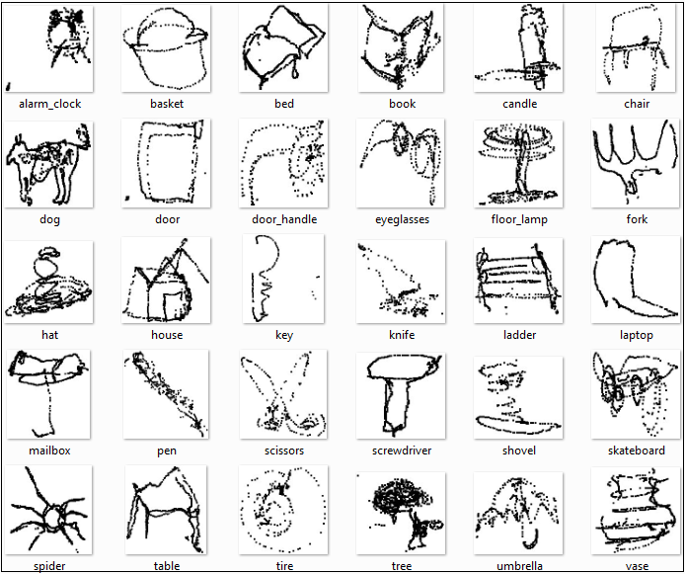

  Benchmark (examples)
Kinect300 Dataset
Training: 7 sketches/class
Testing: 3 sketches/class
3D Target dataset
Notes:
Some examples of the Kinect300 3D sketch dataset and 3D target model dataset are shown here.
To facilitate learning-based retrieval, we randomly select 7 sketches from each class for training and use the remained
3 sketches per class for testing, while all the target models as a whole are remained as the target dataset.

Slide 7
Outline
Introduction
Methods
Evaluation

Slide 8
Methods
Localized Statistical Feature and Manifold Ranking (LSFMR)
Histogram of Oriented Distances (HoD)
Sketch-Based 3D Model Retrieval Based on 2D View Classification using Convolutional Neural Network (CNN-Point, CNN-Edge)
3D Sketch-Based 3D Model Retrieval with CNN-SBR System (CNN-SBR)
3D Sketch-Based 3D Model Retrieval with CNN-Maxout-Siamese (CNN-Maxout-Siamese)
Notes:
In this track, nine runs have been submitted by five groups who contributed to five methods. They are:
Localized Statistical Feature and Manifold Ranking (LSFMR for short)
Histogram of Oriented Distances (HoD)
Sketch-Based 3D Model Retrieval Based on 2D View Classification using Convolutional Neural Network (CNN-Point, CNN-Edge)
3D Sketch-Based 3D Model Retrieval with CNN-SBR System (CNN-SBR)
3D Sketch-Based 3D Model Retrieval with CNN-Maxout-Siamese (CNN-Maxout-Siamese)

Slide 9
Localized Statistical Feature and Manifold Ranking
Yachun Fan, Fuqing Duan, Lu Qian
Beijing Normal University, China

Slide 10
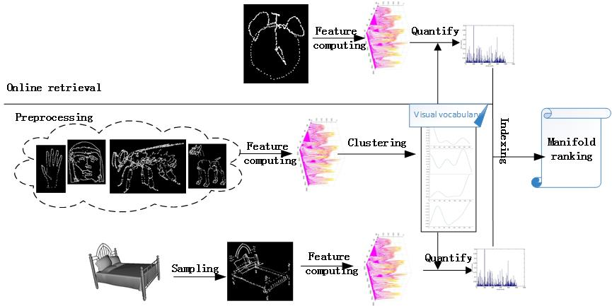
Main Steps
SVM+PCA
k-means
Feature quantification
Reference to NPR methods
Notes:
1. Each local region was divided into same smaller sub-regions called cell
2. All cell accumulated a local 1-D vector as the local region feature representation
3. Local normalization methods was used to normalize values
4. Employ $χ^{2}$ distance to compare two LSF vector:
$χ^{2}\left(F_{1},F_{2}\right)=\sqrt{\sum_{c=1}^{L^{3}}{\left(\frac{F_{1}\left(c\right)−E_{χ}\left(F_{1}\right)}{E_{χ}\left(F_{1}\right)}\right)}+\sum_{c=1}^{L^{3}}{\left(\frac{F_{2}\left(c\right)−E_{χ}\left(F_{2}\right)}{E_{χ}\left(F_{2}\right)}\right)}}$

Slide 11

Sketch-Based 3D Model Retrieval Based on 2D View Classification using Convolutional Neural Network
Yuxiang Li, Maks Ovsjanikov
LIX, Ecole Polytechnique, France
Notes:
Now we introduce Li and Ovsjanikov’s Sketch-Based 3D Model Retrieval Based on 2D View Classification using Convolutional Neural Network

Slide 12
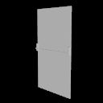
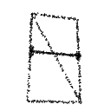
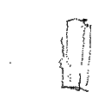
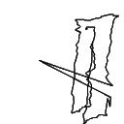

Retrieval Pipeline
3D 2D
Offline Training
3D model
Views
Testing
3D sketch
Edge
Neural Network
Result
Point
Notes:
As we have just shown, the algorithm comprises two stages: offline training and online retrieval.
We should notice that Edge representation can be impacted (even ruined) by outliers, but it is more similar to traditional 2D sketch.
However, when we render target models with noisy point clouds by introducing noises along edges, we find that using 3D sketch directly as a point cloud also gives a reasonable result.

Slide 13
Histogram of Oriented Distances
Hedi Tabia¹ and Hamid Laga²
¹ ENSEA, UCP, CNRS, France
² Murdoch University, Australia

Slide 14

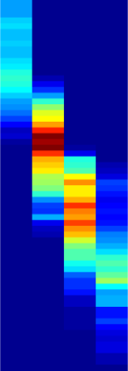
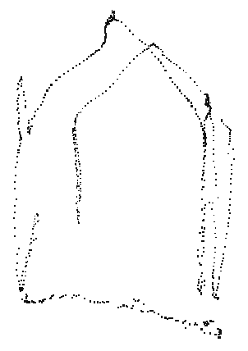


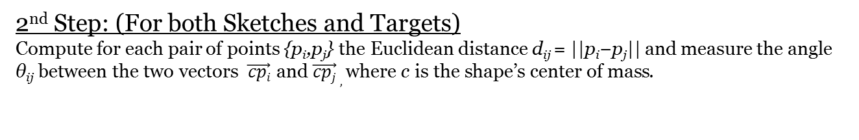
Histogram of Oriented Distances
1st Step: (For Target only)
Randomly sample n points P = {p_{i}, i=1...n} from each target model.
2nd Step: (For both Sketches and Targets)
Compute for each pair of points {p_{i},p_{j}} the Euclidean distance d_{ij} = ||p_{i}−p_{j}|| and measure the angle θ_{ij} between the two vectors $\vec{cpi}$ and $\vec{cpj} ,\text{where} \text{c} \text{is} \text{the} \text{shape}\text{’}\text{s} \text{center} \text{of} \text{mass}$.
p_{i}
d_{ij}
θ_{ij}
p_{j}
$$\text{c}$$
d
d
θ
θ
Notes:
3D sketches and 3D models are represented using the joint distribution of two parameters (distance and orientation) accumulated in a 2D histogram.
The dissimilarity between the sketch and the target object is computed using the L2 distance between the two distributions.
In our implementation, we tested four different histogram sizes 644, 64  2, 64  1 and 1  4, where k  l corresponds to k bins for the distance and l bins for the orientation.

Slide 15
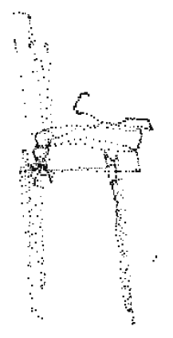
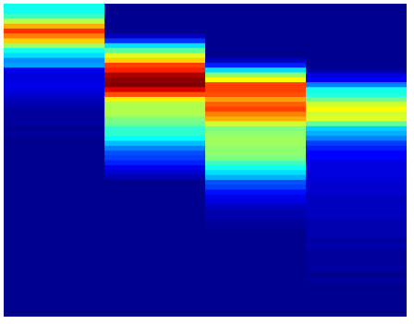
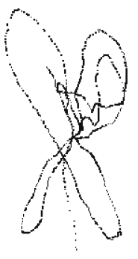
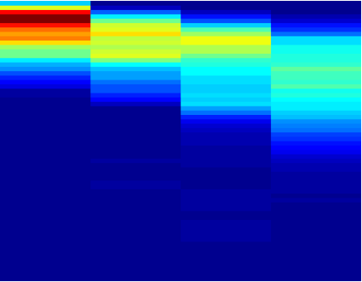
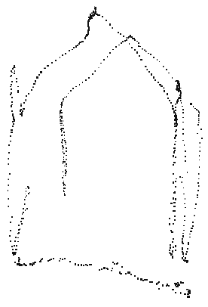
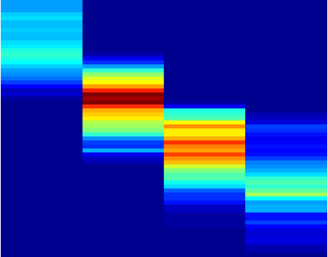
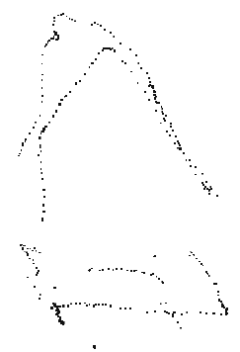
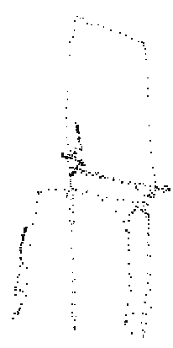
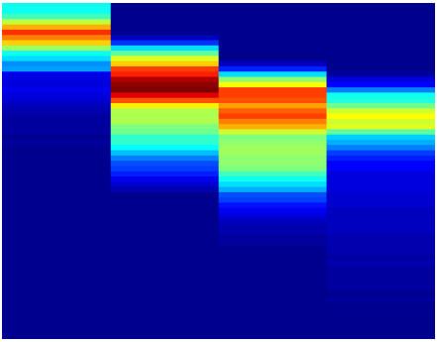
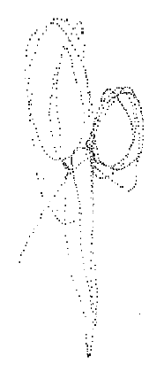
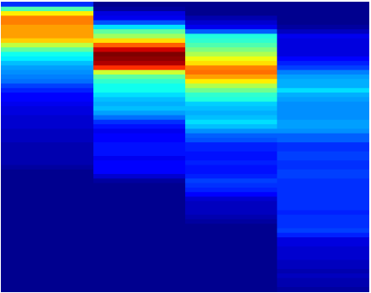
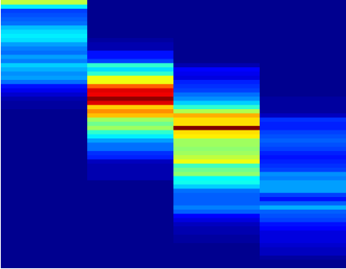
HOD Descriptors from Six 3D Sketches
Chairs
Scissors
Houses

Slide 16

3D Sketch-Based 3D Model Retrieval with CNN-SBR System
Yuxiang Ye¹, Yijuan Lu¹, Bo Li²
¹Texas State University, USA
²University of Central Missouri, USA
Notes:
Now we introduce Li et al.’s Efficient Sketch-Based 3D Model Retrieval Based on View Clustering and
Parallel Shape Context Matching.

Slide 17
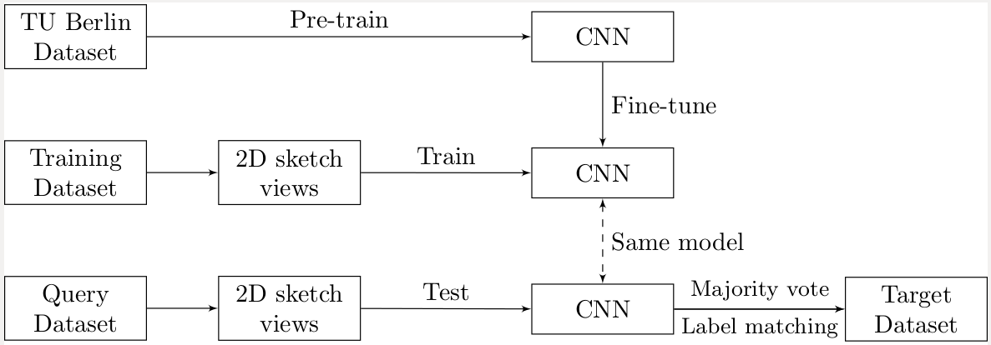
CNN-SBR Architecture
Notes:
17

Slide 18
CNN-SBR
  CNN-SBR applies Sketch-A-Net as core CNN model and pre-train the model using TU Berlin dataset. Use this pre-training technique improves the retrieval performance
  CNN-SBR performs data augmentation on 2D sketch views of 3D sketch, which significantly enlarges the data size and alleviates over-fitting
  Employ semi-mature CNN model after pre-training, which gives initial well-learned weights but still keep the model flexible for the following fine-tuning
Notes:
18

Slide 19
3D Sketch-Based 3D Model Retrieval with CNN-Maxout-Siamese
Huanpu Yin, Shuilong, Dong, Peng Liu, Ziyu Xue, and Haisheng Li
Beijing Technology and Business University, China

Slide 20
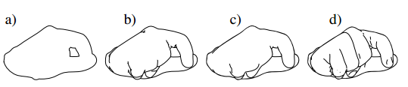
View Definition and Line Rendering Approach
  Comparison of different line rendering technology: silhouette (a), Canny line (b) and contour line (c), suggestive contour (d)
  Two random sample views are chosen if their in-between angles are larger than 45◦ to characterize a 3D model

Slide 21
Maxout
Maxout is a regularized trick of depth network, which can prevent network over-fitting
Activation function:
Maxout Networks,Goodfellow I J, Warde-Farley D, Mirza M, et al. ICML, 2013
Notes:
Given an input x, a maxout hidden layer is computed by
the following activation function:
hi(x) = max j∈[1,k]zi j
where zi j= xTWi j+bi j and the dimension of W is d ∗m∗k, d
denotes the dimension of x, m denotes the number of hidden
layer units, and k indicates the maximum number of “hidden
layer” units.

Slide 22
Learn Feature Representations
The sub-net architecture of Siamese network
Notes:
Siamese network, which typically takes a pair of images
for input, is used to learn feature presentations. The two
sub-nets of Siamese network have the same architecture–
Convolutional Neural Networks (CNN). The sub-net architecture
is shown in here. To solve the over-fitting problem
in CNN, maxout network is chosen.

Slide 23
Cross-Domain Matching and Similarity Computation
Loss function:
Similarity distances between models and sketches are briefly computed by Euclidean distance
Notes:
L isloss function.

Slide 24
Outline
Introduction
Methods
Evaluation

Slide 25
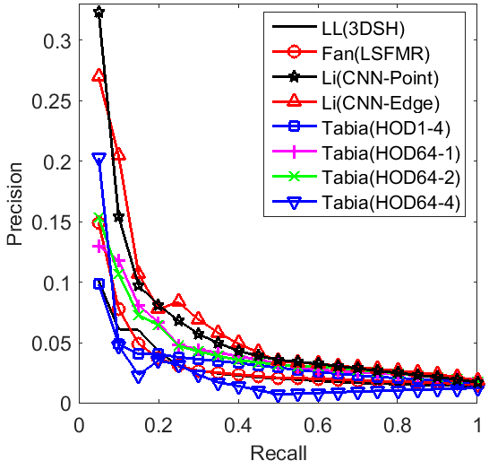
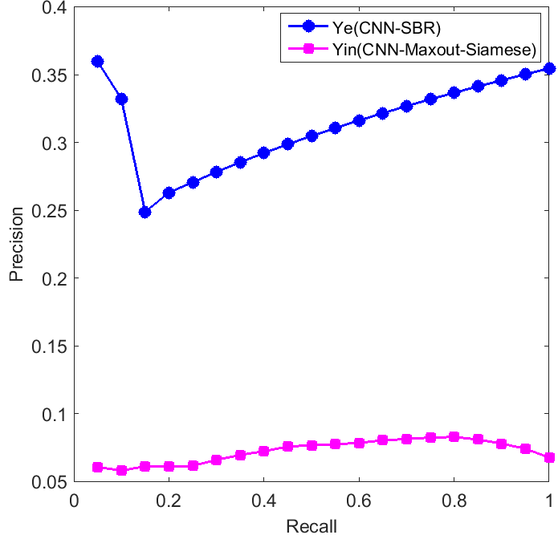
Results: Precision-Recall
Non-learning approaches
(complete benchmark)
Learning-based approaches
(testing dataset)
Notes:
First is the Precision-Recall plots.
There are complete and testing datasets in the benchmark.
They compare three non-learning participating methods
and two learning-based participating methods in terms
of the seven performance metrics on the above two datasets,
respectively. As a baseline, we also provide the baseline method 3D shape histogram, that is LL (3DSH), that we have implemented
in Reference [1].

Slide 26
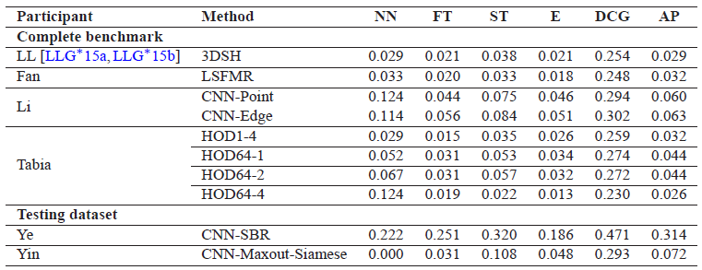
Results: Performance Metrics
Performance metrics comparison on the SHREC’16 3D Sketch Track Benchmark.
Notes:
This table compares other performance metrics, such as NN, FT, ST, E, DCG and AP.

Slide 27
Results: Performance Comparison
Overall Performance: Non-learning based category
  Li’s CNN-Edge and CNN-Point perform the best, followed by Tabia’s HOD method
  The overall performance of all non-learning based methods are close to each other
  All three participating methods outperform the baseline method [1,2]
Overall Performance: learning based category
  Ye’s CNN-SBR outperforms Yin’s CNN-Maxout-Siamese
  More promising overall performance in learning based approaches
Conclusions and Future directions
  Develop algorithm scalable to diverse queries: 2D/3D sketch/image
  Adaptive feature learning approaches, i.e. deep learning
Notes:
Now we comment on their performance to identify future trends.

Slide 28
Results: Method Classification
Classification of participating methods w.r.t techniques employed
  Local versus global features: Five participating groups utilized local features, the baseline [LLG15*15a] employs a global feature
  Deep learning: Three groups (Li, Ye, Yin) employed deep learning for feature learning
  Statistical local features: Two groups (Fan and Tebia) extract a statistical distribution of local features to represent 3D sketch/model
Notes:
Finally, we classify all participating methods with respect
to the techniques employed.

Slide 29
Thank you!
Any Questions?

